Slide 1



THE VALUE OF 168
LSEG Due Diligence Centre (formerly Refinitiv)
Training Manual

Slide 2

Contents
Key Contacts………………………………3
What is LSEG?...............................4
The LSEG Workflow……………………5
LSEG & Centre-led initiatives……..6
Introduction to LSEG………………….7
Adding a Third-Party onto LSEG…8
The Risk Analyser…………………….12
World Check Screening……………14
Adverse Media Check……………..27
Onboarding a Third-Party………..31
Assigning Questionnaires………..47
Enhanced Due Diligence………….76
World Check Updates Process…77
Renewal Process……………………..84

Slide 3

Key Contacts
RPM Compliance Team:
Shelley Earl Senior Director of Global Compliance | searl@rpminc.com
Caroline Watson Director, Compliance & Ethics - Europe | cwatson@rpminc.com
Helen Dillon Manager – Compliance and Ethics | hdillon@rpminc.com

Slide 4

What is LSEG Due Diligence Centre?
LSEG Due Diligence Center (LSEG), is a Third-Party Due Diligence Management Platform that will replace Truth Technologies, historically used to complete World-Check searches against third-parties intending to transact with RPM and it’s subsidiaries.
LSEG will enhance and standardise Third-Party Management across the organisation, provide a fully integrated approval system through the use of pre-defined Workflows and increase visibility of third-parties across the globe.
LSEG is a huge step forward for RPM and will significantly mitigate against corruption & bribery risk and facilitate trade compliance across all operating companies.

Slide 5
LSEG Workflow
New 3rd Party - onboarding
Risk Analyzer & World Check Report
Review of World Check Hits and Medium/High Risk Parties
Internal Questionnaire – enhanced DD
External Questionnaire to 3rd Party – enhanced DD
LSEG Reports – enhanced DD (ADDITIONAL COST)
Continuous Monitoring in Worldcheck*
Sustainability and Responsible Sourcing DD will be conducted for larger and higher risk suppliers alongside the LSEG workflow – this will be center-led at RPM
Low risk – Approved
World check hit, Medium or High Risk
Approved
Approved
Declined
Declined
Continue with onboarding to gather more data
Continue with onboarding to gather more data
Approved
Approved
Declined
Declined
Continue with onboarding to gather more data
*Note all approved parties will include continuous monitoring

Slide 6
LSEG & Sustainable Procurement:
A Centre-led Initiative
Third Party Due Diligence
(LSEG)
Sustainability Assessments
Responsible Procurement
(Centre-led Procurement Team)
LSEG will form part of a much wider RPM Centre-led Workflow, focussed on fully vetting all third-party VENDORS from a Compliance, Sustainability and Responsible Procurement perspective in line with RPM’s Building a Better World objectives.
As such, the management of customers and vendors will be slightly different in LSEG.
Customers will be fully managed at local entity level, whereas approval of third-party vendors will be managed centrally by the RPM Compliance team. This will ensure that large & high-risk third-party vendors are submitted for assessment of their sustainability credentials.
Any questions about the impact this will have on your local business, please contact the RPM Compliance team.

Slide 7
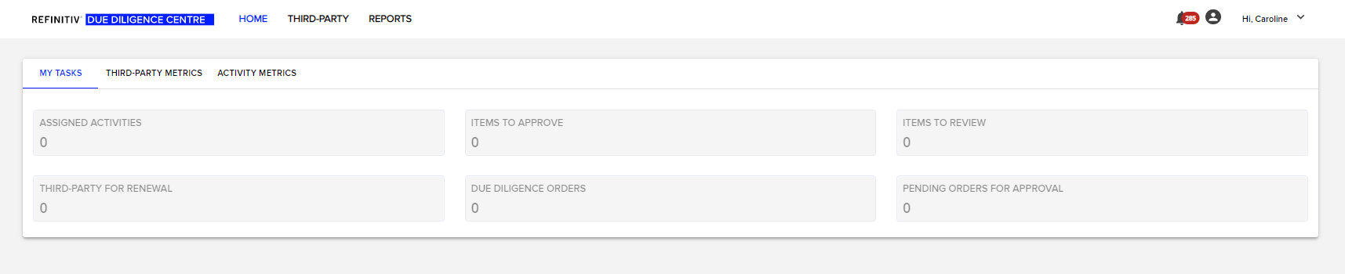
The LSEG Platform: An introduction
The initial home screen of the LSEG platform provides the User a dashboard to easily view their current activity / assigned task status.
Each User in LSEG is assigned a role, either Onboarding (responsible for entering third party data) or Approval (responsible for approving third parties in the system).
Users are also assigned Divisions and will only have visibility of their specific divisions as assigned to them.
In general, the two divisions that will be used at operating entity level are:
The Entity Specific Division (e.g. Carboline Inc, Stoncor South Africa)
RPM Suppliers – Carboline Inc., etc.
This will protect third party data being visible across businesses and also enables the centralisation of supplier data as part of RPM’s centre-led workflow (refer to slide 6).

Slide 8
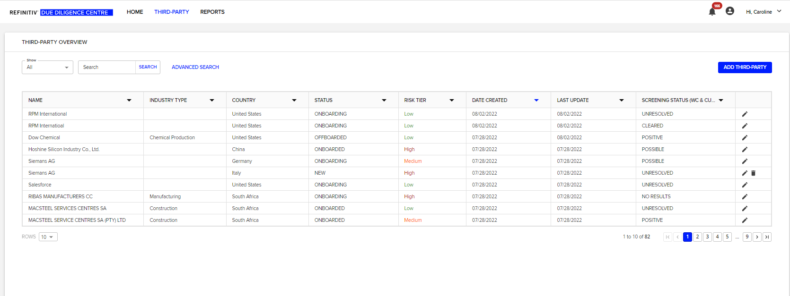
Adding a New Third Party onto LSEG
Completed by the Onboarding Team
From the Home Screen, select THIRD-PARTY from the Top Menu to take you to the Third-Party Overview for your organisation.
To avoid duplication, before you add a third party into the system, you must first check that it does not already exist. Use the ADVANCED SEARCH (functionality is much better than the general search box) to check for pre-existence of third-parties.
If the third-party exists and is approved in the system, you can proceed transacting with third party. If the third-party exists and is denied in the system, contact the RPM Compliance Team
If the third party does not exist, click on ADD THIRD PARTY to create a new third-party record.

Slide 9
Adding a New Third Party onto LSEG
Once you have clicked on ADD THIRD-PARTY, you are taken to a new screen where you are prompted to complete a range of information about the Third-Party. These are divided into the following categories:
  General Information
  Third-Party Segmentation
  Address
  Contact
  Screening Criteria
  Description
Only certain fields are required to be completed as part of RPM’s Third Party Due Diligence Procedures.
The fields required to be completed are included overleaf:

Slide 10
Adding a New Third Party onto LSEG
The completion of certain information in the ADD THIRD-PARTY section is required to perform the World Check Screening for the Third-Party and also to drive the risk analyser, which is used in conjunction with the World-Check Search to assess the overall risk profile of the Third-Party. The World-Check Search and the Risk Analyser will be covered in subsequent sections of this Training Manual.
The Information that is CRITICAL to the effective use of the LSEG Tool and must be entered is:
General Information
Name: Enter the official full name of the Third-Party
Third-Party Segmentation
Commodity Type: Use drop down function to choose nature of business relationship with Third-Party (see next page for commodity type definitions)
Address
Country: Full address of Third-Party is not required, albeit recommended. However, the country in which they are registered is
Reference Number: Unique identifier, recommend to follow local ERP reference denotation. If the reference number already exists, you will be notified by the system.
Industry Type: Use drop down function to select Third-Party Industry Type
Revenue: For customers, enter the anticipated sales value with the third-party, for suppliers, enter the anticipated spend value (in USD).
Once you have completed the required fields, scroll to the bottom of the screen and click SAVE.
As soon as you click SAVE, the LSEG system does 2 things:
  Performs a World-Check/Media Check Search against the Third-Party
  Provides a Risk Score of the Third-Party using the Risk Analyser

Slide 11
Adding a New Third Party onto LSEG
RPM Commodity Type
Government Entity (Direct / Indirect): The ultimate end user of the product(s) is a Government owned or partially owned entity. This can either be through Direct purchase, or indirectly via a Distributor or installer / applicator.
Customer End User: The recipient or purchaser of products of the Company that ultimately uses the product and does not resell the product
Export Customer Distributors: Purchaser of a product that intends to resell to a customer outside of the country in which you are located e.g. US RPM Company sells to Distributor based in Mexico who sells to End-Users based outside the US.
Installers / applicators: Purchaser of a product that intends to install on behalf of the end-user
Joint Venture Partner: Those with whom the Company has entered into a business agreement to establish a new business entity and/or manage assets
Domestic Customer Distributor Purchaser of a product that intends to resell to a customer within the country in which you are located e.g. RPM Company, Distributor and End-User are all based in Germany
Advisor/Intermediary: Advisor who independently or directly Files Documents or Represents RPM or its subsidiaries to governmental agencies, courts, or investors
Advisor/Intermediary: Provide technical or SME advice on behalf of the Company by representing the Company to another person, business, entity or government official
Agent: Authorized to act for, or on behalf of, the Company in furtherance of the Company’s interests e.g. sales agents, customs brokers, permit agents
Contractor/Subcontractor: Provide goods or services to the Company under contractual terms but otherwise are not under the control of the Company e.g. installers/repairers
Direct Supplier/Vendor: Supply Raw Materials and Packaging used by the Company
Logistics/Freight forwarding
None Direct Supplier / Vendor: Supply parts, components and overhead & miscellaneous items used by the Company
Service Provider: Provide functional services or support to the Company (e.g. communications, storage, processing service, IT services, marketing services, financial services
Supplier Distributor: Seller of a product that resells on behalf of manufacturer(s)
Other

Slide 12
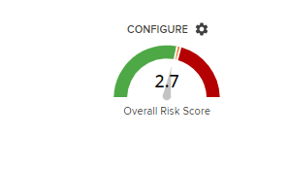

The Risk Analyser
The Risk Analyser is a tool built into the LSEG platform to help provide a high level overview of the risk profile of the Third-Party.
The Risk Analyser is run independently of the World Check/Media Check Screening function and the score is driven by the information completed in the ADD THIRD-PARTY section.
This is why it is critical to complete certain fields, as per instructions on page 10 to ensure the risk analyser can calculate an appropriate risk score.
Depending on WHERE the company is located, the TYPE of business relationship (commodity type), the INDUSTRY of the Third-Party and anticipated VALUE to the organisation, the tool will determine what the inherent risk of the third-party is.
Third-Parties are scored as either LOW, MEDIUM or HIGH risk in the Risk Analyser dependent on the overall risk score.
The example above shows that RPM International scores LOW RISK with a score of 2.7
The Risk Analyser score will have an impact on how Third-Parties are assessed as part of RPM’s Third-Party Due Diligence Procedures. This will be covered in a later section.

Slide 13
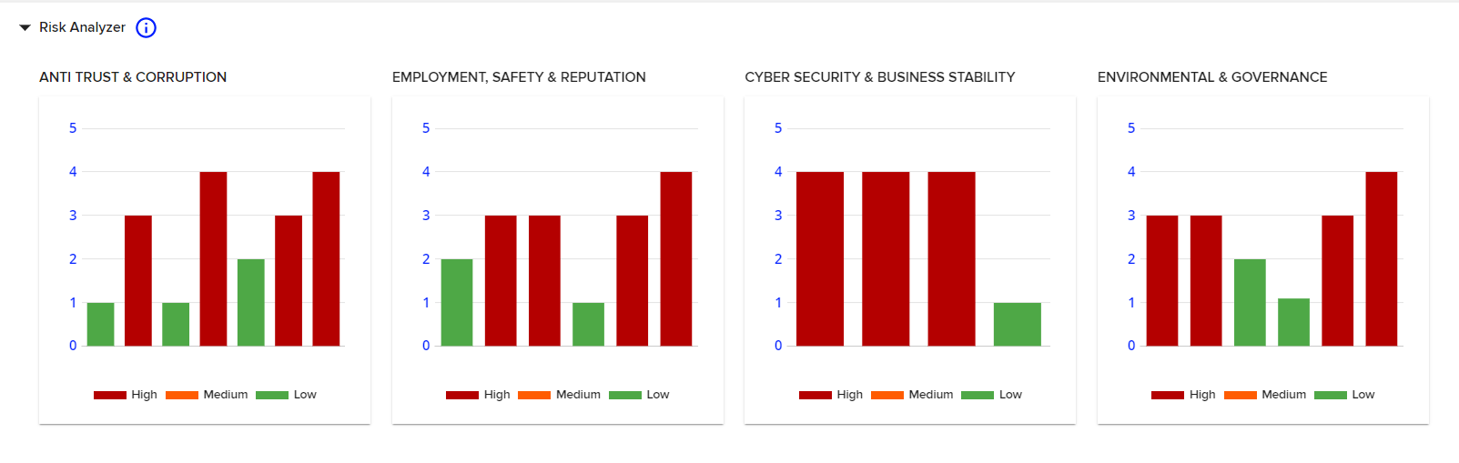
The Risk Analyser
The Overall Risk Score for the Third-Party is calculated across 23 different risk areas. Below the initial Risk Score Speedometer, you can see how the Third-Party scored on each of the 23 risk areas. If you hover your mouse over each column of the graphs, it will show you that particular risk area. The 23 risk areas are grouped into 4 main categories, as shown in the screen shot above.
Reminder: This is driven by ONLY the data entered in the initial ADD THIRD PARTY screen. The World Check/Media Check Screening results do not form part of the Overall Risk Score.

Slide 14
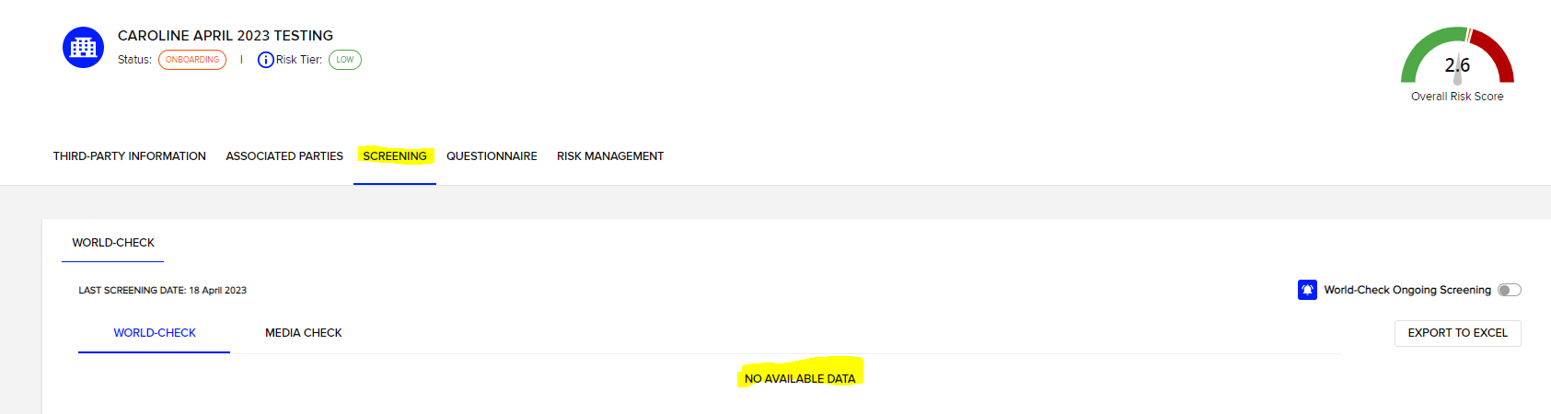
World-Check Screening
Based on the Third-Party name and Country information as updated in the ADD THIRD-PARTY section of the tool, the system will automatically run a World-Check search.
The results of the screening can be found on the SCREENING tab at the top of the page, under the risk analyser.
If there are no results, the screening section will state NO AVAILABLE DATA as per the example below:

Slide 15
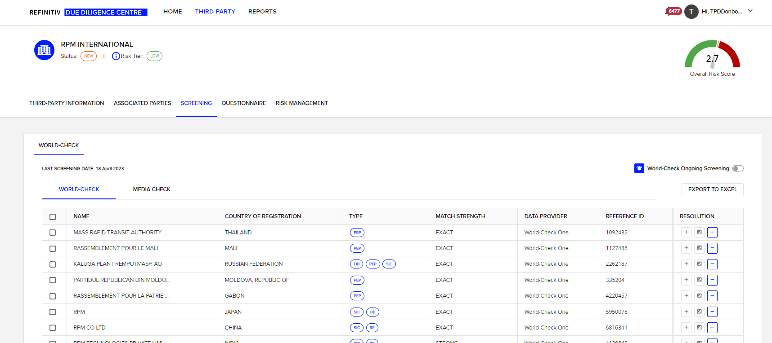
World Check Screening Continued…
If there are potential World Check Screening results, these will be listed on the SCREENING tab as per the example below:

Slide 16



World-Check Screening
The system will provide you the following information about the potential Third-Party screening matches:
Name
Country of Registration (make sure the country matches the country of registration of the third party you are screening and is not the HQ country location of the third-party).
Type of issue that has caused the Third-Party to “flag” on World-check (if you hover your mouse over the Blue ovals, it will tell you more information)
Match Strength of the potential Third-Party to your entered search term
The Source: World-Check one
The reference ID of the potential match in World Check
Resolution Options
The Resolution Options are:
POSITIVE
FALSE
POSSIBLE
These are covered in more detail on the next page…

Slide 17
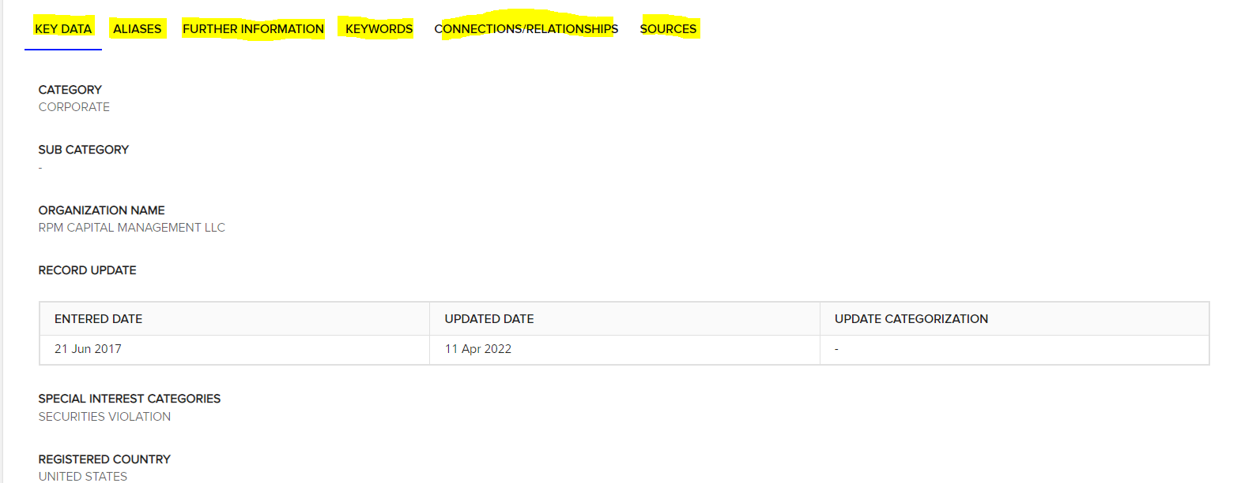
World-Check Screening
World Check Screening is completed by the ONBOARDING TEAM
To perform the World-Check Screening, the below steps need to be followed:
1. Click on each of the Third-Parties to be taken to the full World-Check Results. There are a number of tabs (as highlighted yellow below) within the screening results you can click through to be able to review whether the Third-Party is a match or not.

Slide 18
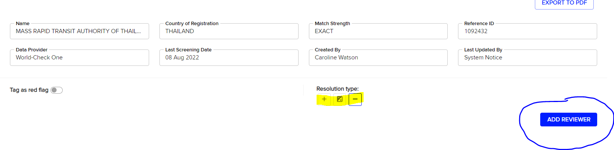
World-Check Screening
Once you have reviewed the information, you need to resolve the Third-Party and designate the results as either:
POSITIVE: The Third-Party is a MATCH
FALSE: The Third-Party is NOT a MATCH
POSSIBLE: The Third-Party COULD be a MATCH
Results can be marked up as such in 2 ways, either within the Third-Party individual screening results page by clicking the positive negative or possible icon as highlighted below, or on the initial screening page where all potential world-check screening matches are listed (see page 10 for example)
If you are unsure whether a search result is a positive match and you want another team member to review / double check the possible match, you can do so by clicking the ADD REVIEWER BOX below. (Note: This is not mandatory).

Slide 19
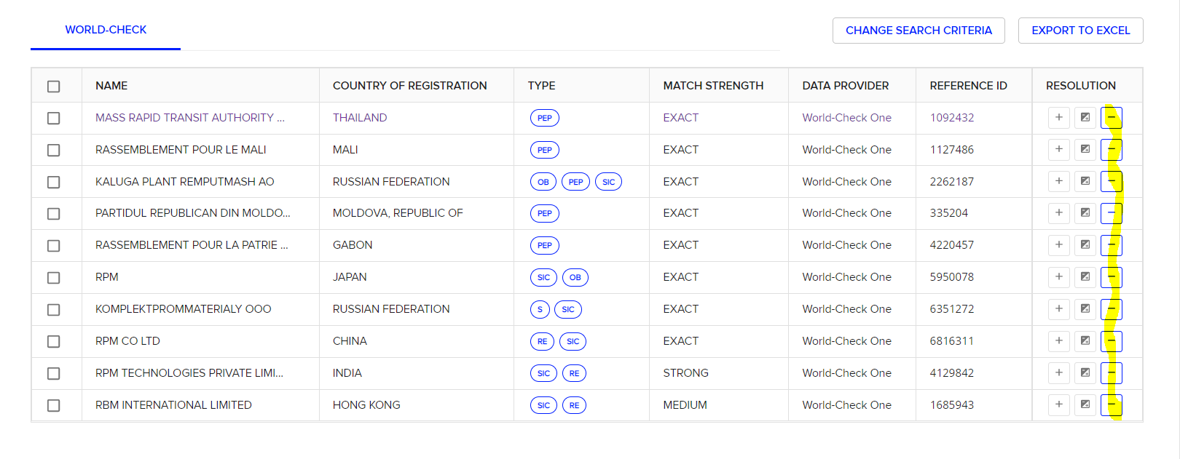
World-Check Screening
In the screening results page, you can either individually mark the results one by one, or if you tick the Select All box, or multiple boxes on the left hand side, you can resolve more than one at a time (see next page for screenshot)

Slide 20
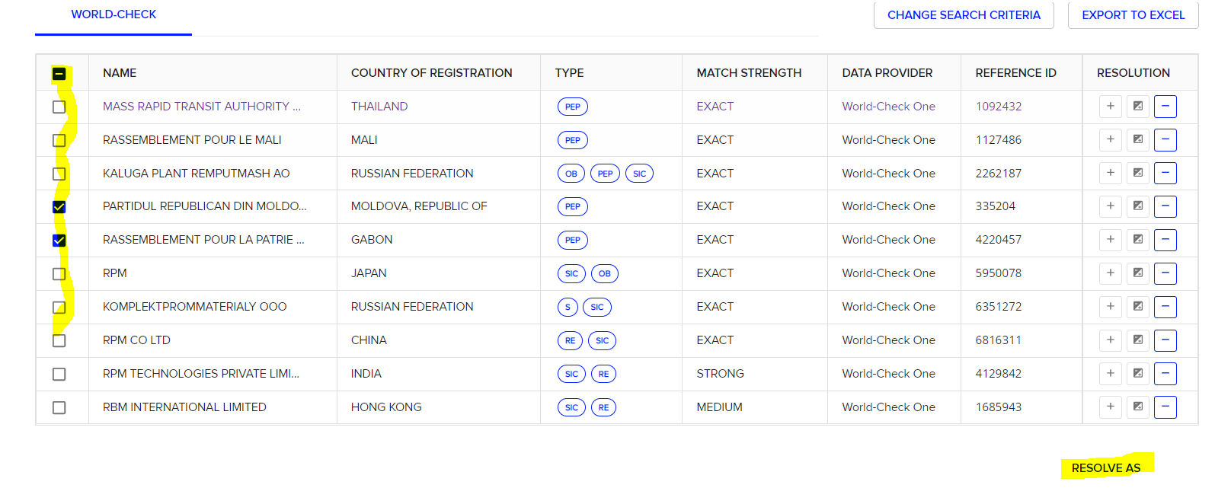
World-Check Screening
When you Select All or multi-tick boxes, a RESOLVE AS option appears in the bottom right, allowing you to multi-resolve.

Slide 21
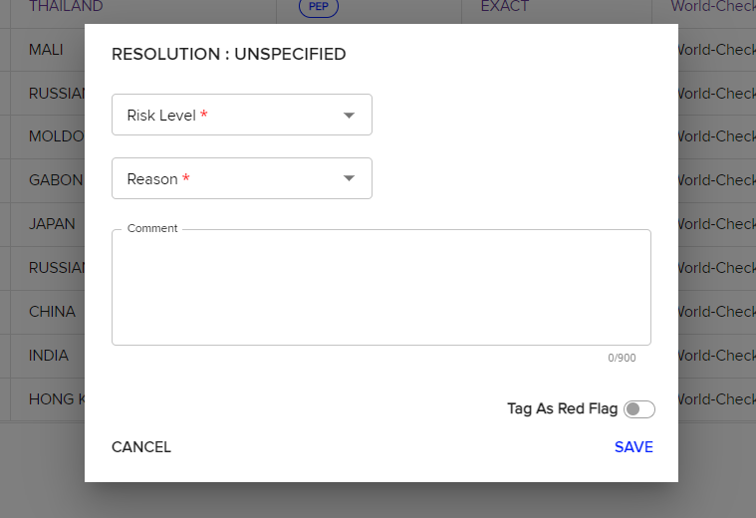
World-Check Screening
Once you select a resolution, a pop-up box will appear asking you to assign a Risk Level and a Reason. If you have selected FALSE, the risk level and reason will only have one option: Unknown. For Positive or Possible Matches, choose the risk level as per the risk analyser score (i.e. HIGH, MEDIUM or LOW). For Positive results, choose FULL MATCH as the reason and for Possible results, choose PARTIAL MATCH as the reason.
Then click SAVE.
There is an option to Tag a third party as a red flag. This is not mandatory, it is just an internal marker you can decide to use if you wish. It has no impact on the process.

Slide 22
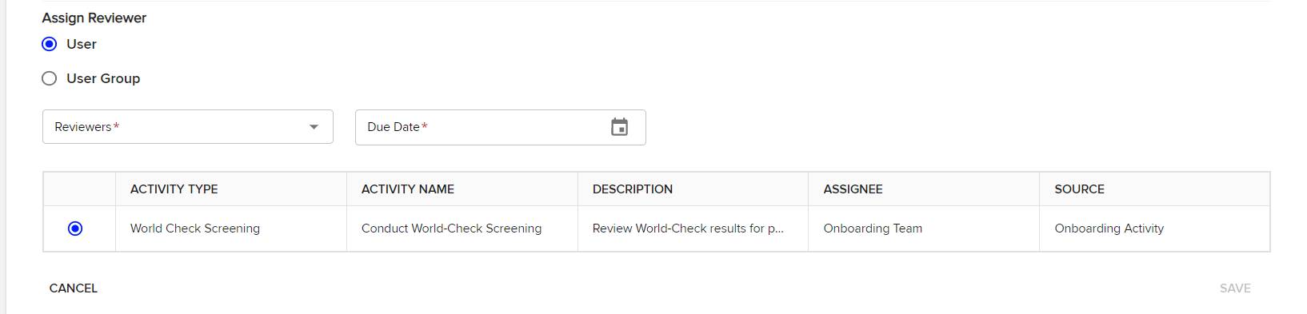
World-Check Screening
If you want to add a Reviewer to a World-Check Screening (usually if you are not certain whether a possible match is a false-positive or not), you can click ADD REVIEWER within the detailed Third-Party Screening results (see earlier page). Once you click ADD REVIEWER, the below section will appear.
You can either add a specific User, or a User Group, which in most cases, would be the Approval Team. You can however ask other members of the Onboarding Team to also review.
You are able to request a specific date you want the review to be completed by.
Once you have selected your User or User Group, click Save.
If you have selected a User, that person will receive an email. If you have selected a Group, all the Users in that Group will receive an email.
An example of the email received by the reviewer is included on the next page…

Slide 23
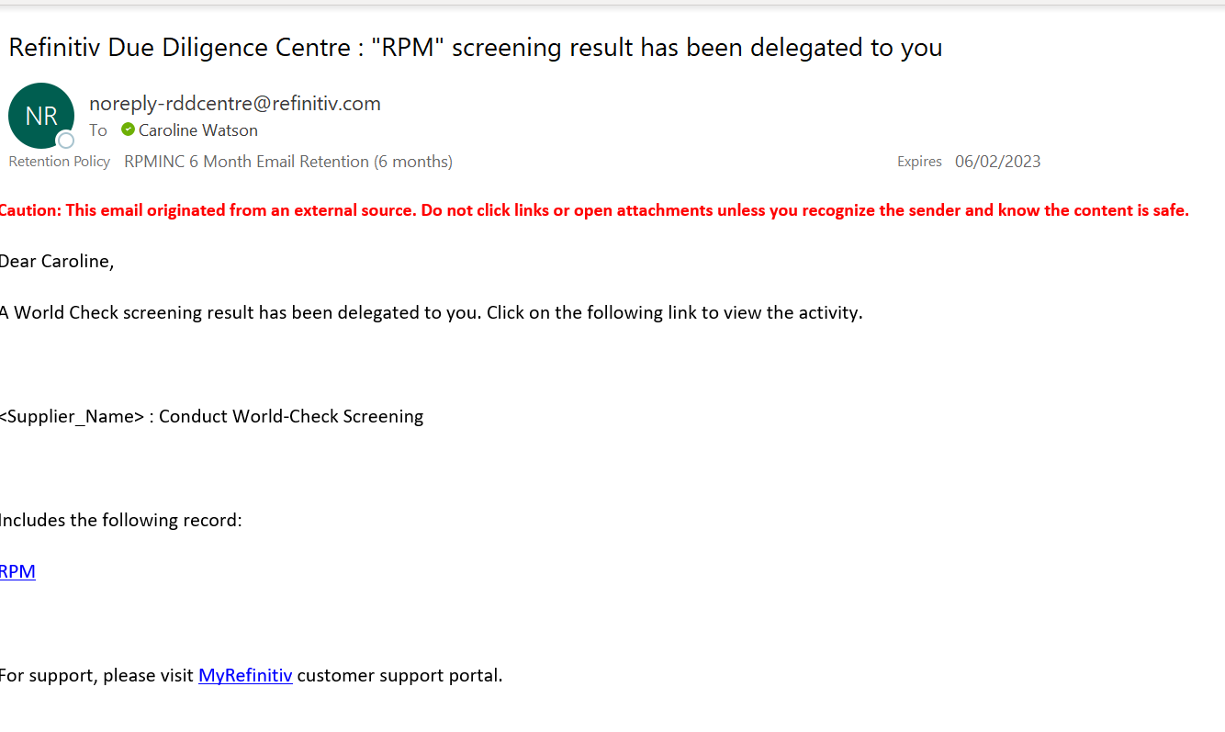
World-Check Screening

Slide 24
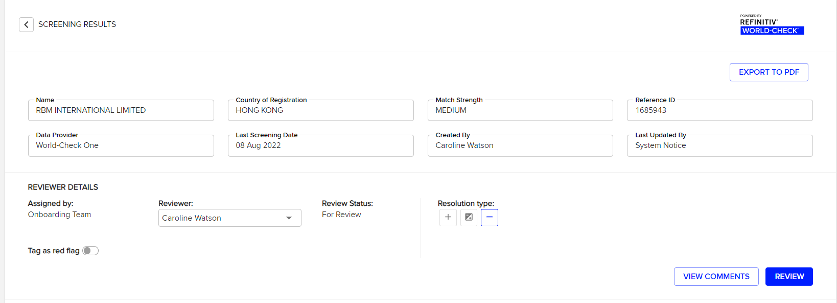
World-Check Screening
The Reviewer can click on the link in the email, where they will be taken to the Screening Result that needs additional review. The Reviewer can add comments and amend the Resolution of the Third Party. Once they have made their comments and performed their review, Click on the REVIEW button. Once this is completed, the Onboarding Team will receive an email, an example of which is include on the next page…
There is an option to Tag a third party as a red flag. This is not mandatory, it is just an internal marker you can decide to use if you wish. It has no impact on the process.

Slide 25
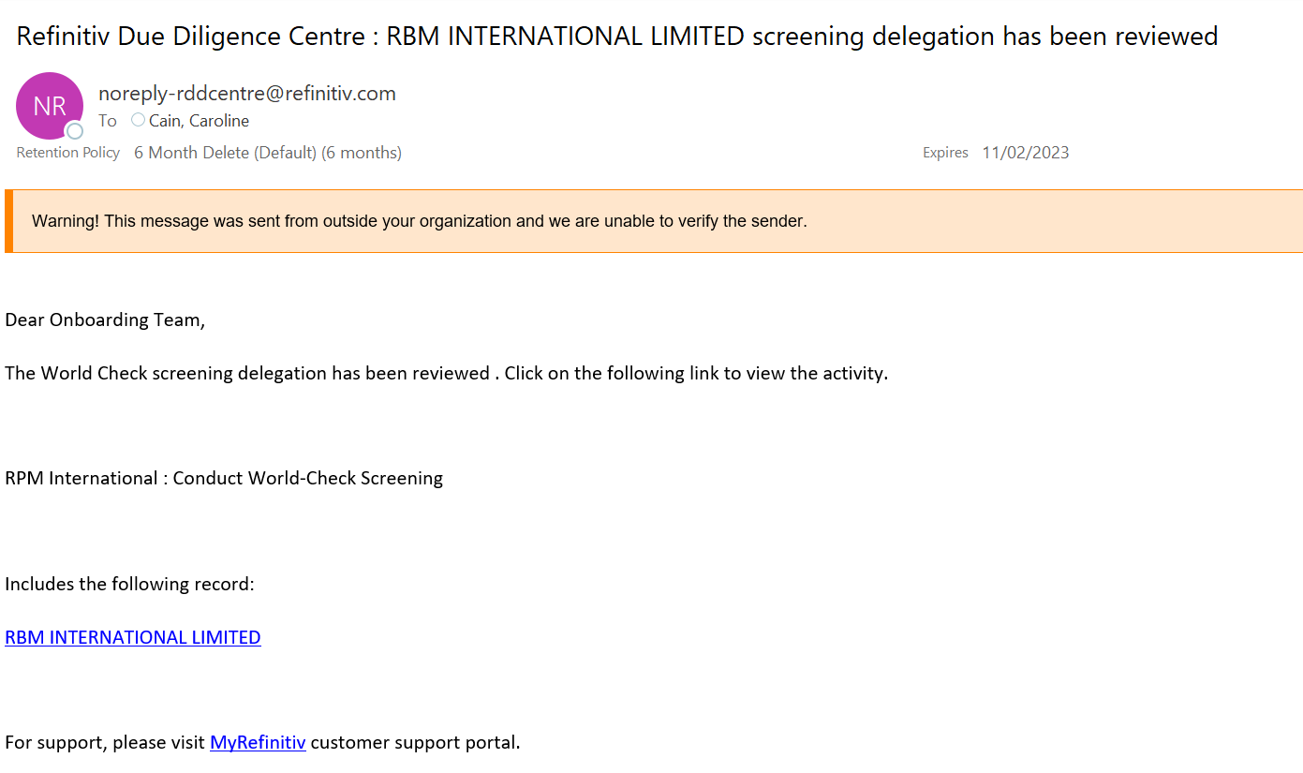
World-Check Screening

Slide 26
World-Check Screening
Tips for Identifying whether a Third-Party Screening result is POSITIVE or FALSE:
Check whether the match strength is Exact, Strong, Medium or Weak (the weaker, the less likely it is to be a match, to speed your search you can review exact and strong matches first).
Check the Country of the possible world check-screening result, but also be aware of companies within the same corporate structure (i.e. parent companies, subsidiaries, sister companies etc) that may be a match and that might have an impact on your Third Party Due Diligence.
Within the Detailed Screening result, utilise the Tabs to review the information about the possible match:
Utilise the Sources Tab to review any external information connected to the screening result to verify whether the screening result is a match or not.
If you are unsure, mark as POSSIBLE and add a REVIEWER as outlined in the earlier pages for someone else to double check the results.
Speak to RPM Compliance Team if additional assistance required.

Slide 27
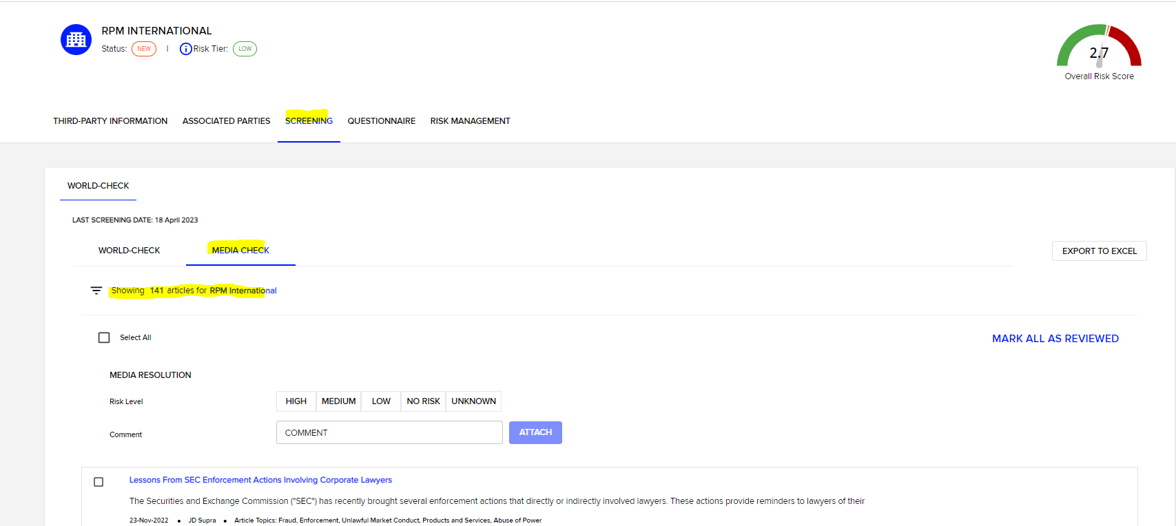
Adverse Media Check
In addition to the World Check screening, LSEG also provides Adverse Media Check screening, which is a new requirement to RPM’s Third Party Due Diligence Procedures.
The Adverse Media Check tool works by flagging any articles published online which may be of relevance to our Due Diligence process.
The reason why this is required is that World Check will only flag any issues that have been pre-determined, whereas the Adverse Media Check will potentially flag new and ongoing issues we need to be aware of but are not yet showing on World Check.
The Adverse Media tool is located within the SCREENING tab as per the screenshot below…

Slide 28
Adverse Media Check
For any articles that have been highlighted in the Adverse Media Check Tool, you are required to review them, mark any articles of relevance as either HIGH, MEDIUM, LOW, NO RISK or UNKNOWN.
Articles that would be relevant for the purposes of third-party due diligence would be in relation to any of the following:
Bribery / corruption
Breach of local / international law
Trading issues: sanctions / import & export issues
Human Rights Abuses
Breach of environmental law
Significant red flags relating to integrity of third-party
Please reach out to the RPM Compliance Team for any assistance required in understanding whether an article is relevant to RPM’s Third Party Due Diligence Procedures.

Slide 29
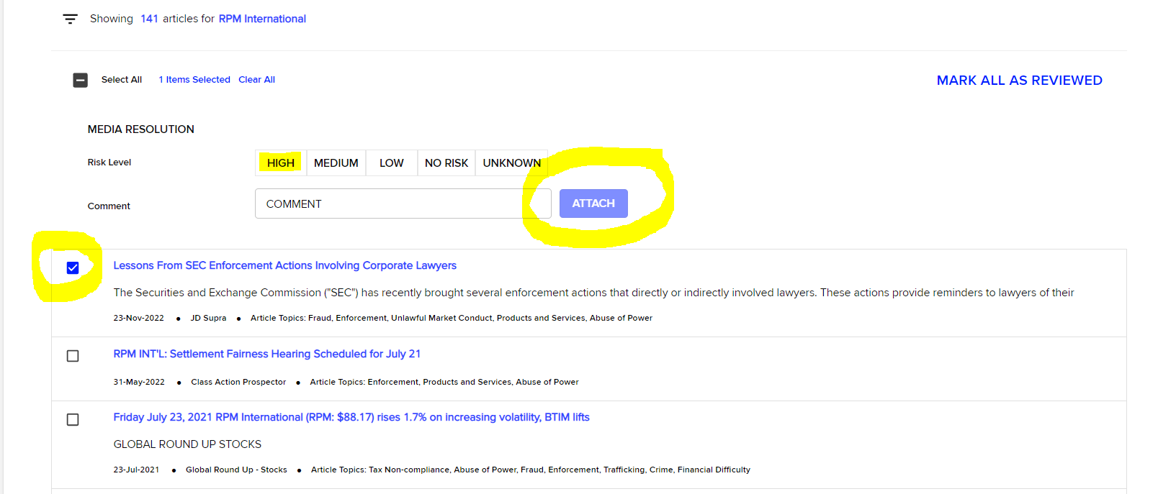
Adverse Media Check
To assign a RISK LEVEL to an article, check the box adjacent to the article, select the risk level and click ATTACH, adding additional comments in the comments box if you would like to highlight anything specific to the review team:

Slide 30
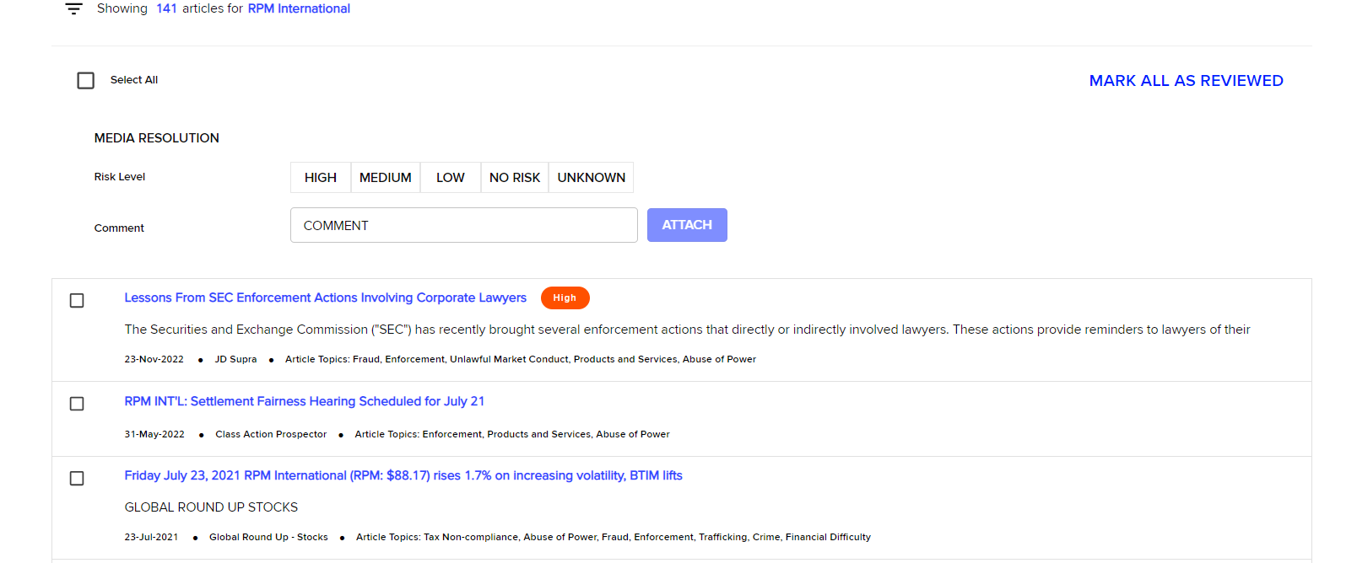
Adverse Media Check
This will then update the article to reflect the risk level assigned by the onboarding team completing the adverse media check.
If there are no articles to highlight / assign a risk, you can simply click the MARK ALL AS REVIEWED option at the top right as per the screenshot below, otherwise any irrelevant columns can be marked as NO RISK
NOTE: You must assign a risk level to all articles or MARK ALL AS REVIEWED or else the task will be shown as incomplete in the system.

Slide 31
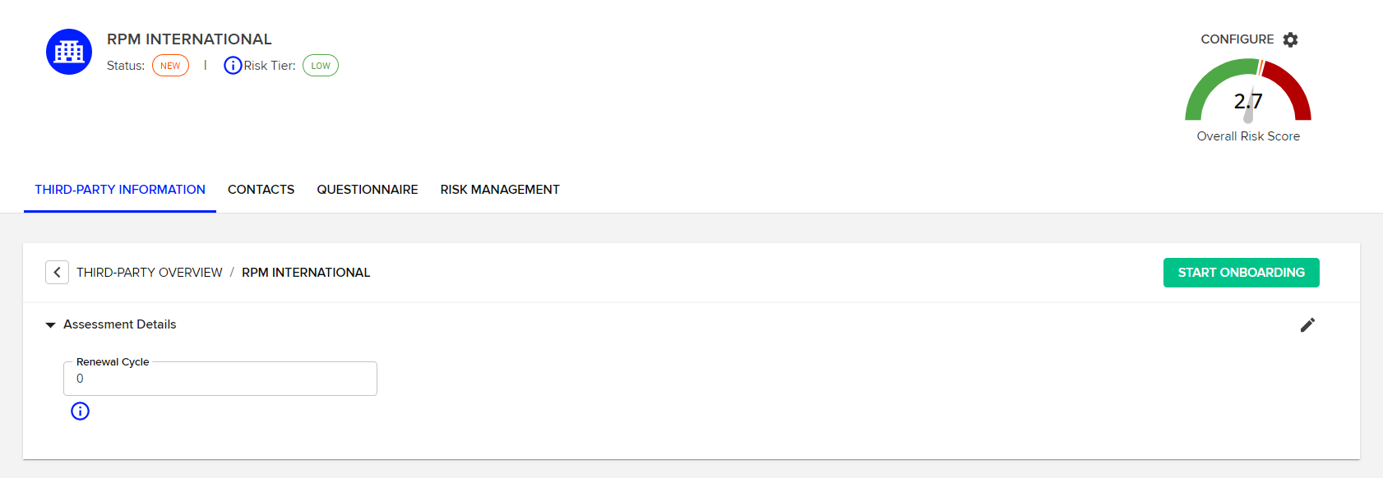
Onboarding a Third-Party
Completed by the ONBOARDING team and the APPROVAL team,
Once you have completed the review of possible World-Check Screening matches and the Adverse Media Check, it is time to start onboarding your Third-Party.
Scroll to the top of the THIRD-PARTY INFORMATION tab (i.e. where the Risk analyser and world-check screening results are) and click, START ONBOARDING.

Slide 32
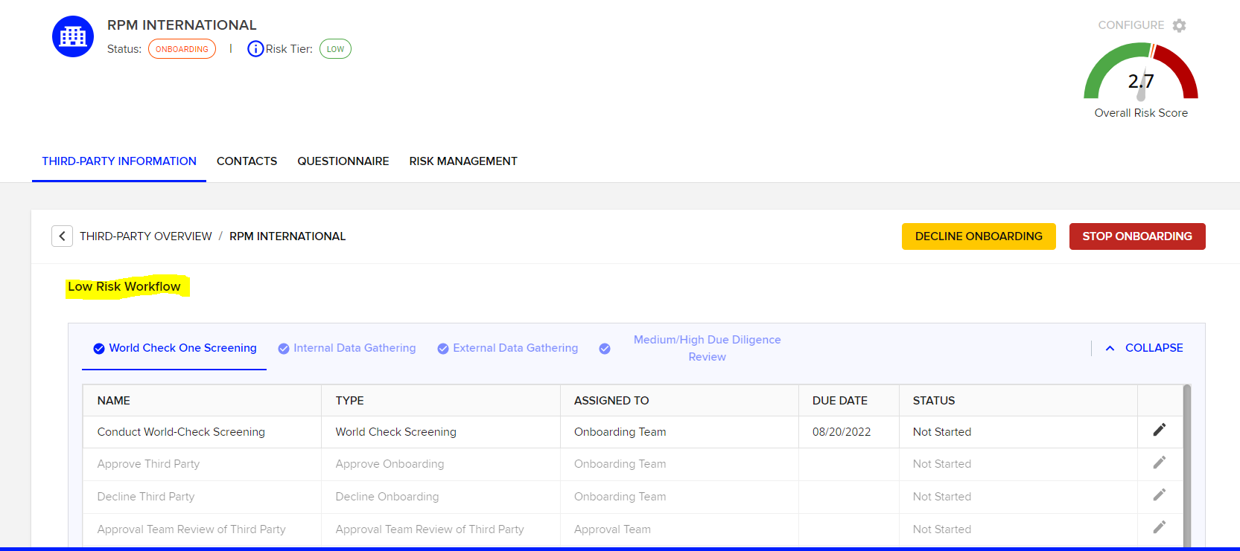
Onboarding a Third-Party
Once you have clicked, START ONBOARDING, you are taken to the “Workflow”, which is a set of activities, governed by whether the Third-Party scored LOW, MEDIUM or HIGH on the Risk Analyser:

Slide 33
Onboarding a Third-Party
As can be seen in the screenshot on the prior page, there are a total of 4 different stages of activity within the Workflows that can be completed as part of the Third-Party Due Diligence Process:
World-Check Screening (this is effectively recording the results of the world check screening review)
Internal Data Gathering
External Data Gathering
Medium / High Due Diligence Review
Each stage is completed as the risk of the third-party is assessed. Higher risk third-parties may complete all four stages, while lower risk third-parties may only complete the first stage.
A Third-Party that scored Low risk on the risk analyser may complete all 4 stages of the workflow as additional data is gathered that drives risk, while a third-party that scores High risk on the initial risk analyser might only complete the first stage.
This is explained in further detail on the subsequent slides…

Slide 34
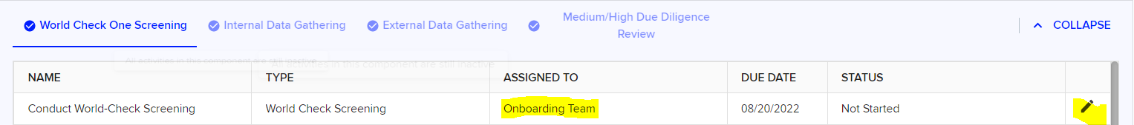
Onboarding a Third-Party
Stage 1: Update Results of World Check Screening
Each stage of the workflow has a set of “activities” that have to be completed.
The first activity that has to be completed is to mark complete the results of the world-check screening (see section 3 above) and record the Risk Analyser score.
To complete the Activity, click on the Pencil (edit) icon as highlighted below:
Clicking on the edit icon takes you to the Activity Information page, where all the required elements of the activity are detailed in a Description Box and a host of drop down boxes to be completed by the Onboarding Team.
These are covered on the next pages…

Slide 35
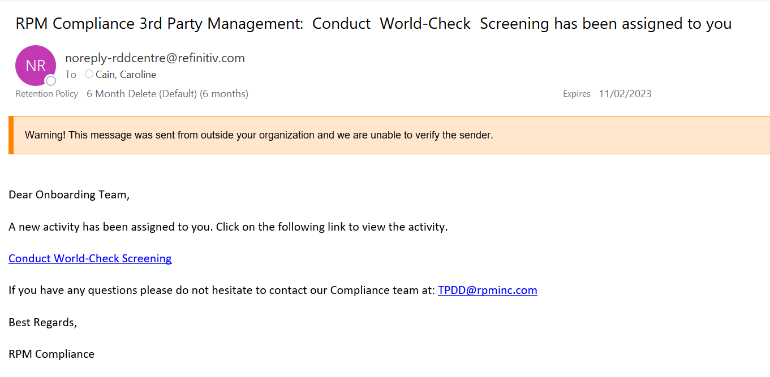
Onboarding a Third-Party
As soon as the Onboarding Team member selects the Activity, they will be sent an email, an example of which has been included below:

Slide 36
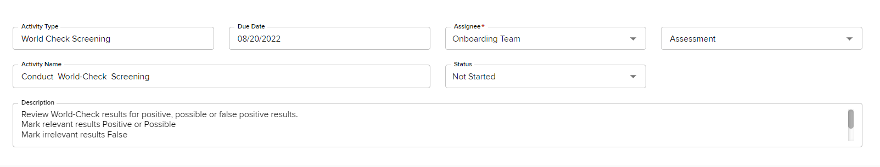
Onboarding a Third-Party
To complete the activity:
Assignee: Start to type your name or select your name from the drop down list
Change Status to Done
Under Assessment select the results of the World-Check Screening.
Possible Assessments include:
  Low Risk w/o Hits: The Risk Analyser scored LOW and there were NO world-check positive matches
  Medium Risk w/o Hits: The Risk Analyser scored MEDIUM and there were NO world-check positive matches.
  High Risk w/o Hits: The Risk Analyser scored HIGH and there were NO world-check positive matches.
  Possible World Check Hits Found: Regardless of the Risk Analyser score (I.e. can be low, medium or high), there was a positive or possible match in the world-check screening
  Decline Third Party: The World Check Screening results were positive and flagged something which means the Third-Party should be immediately declined, such as being linked to a restricted party or registered in an embargoed country.

Slide 37
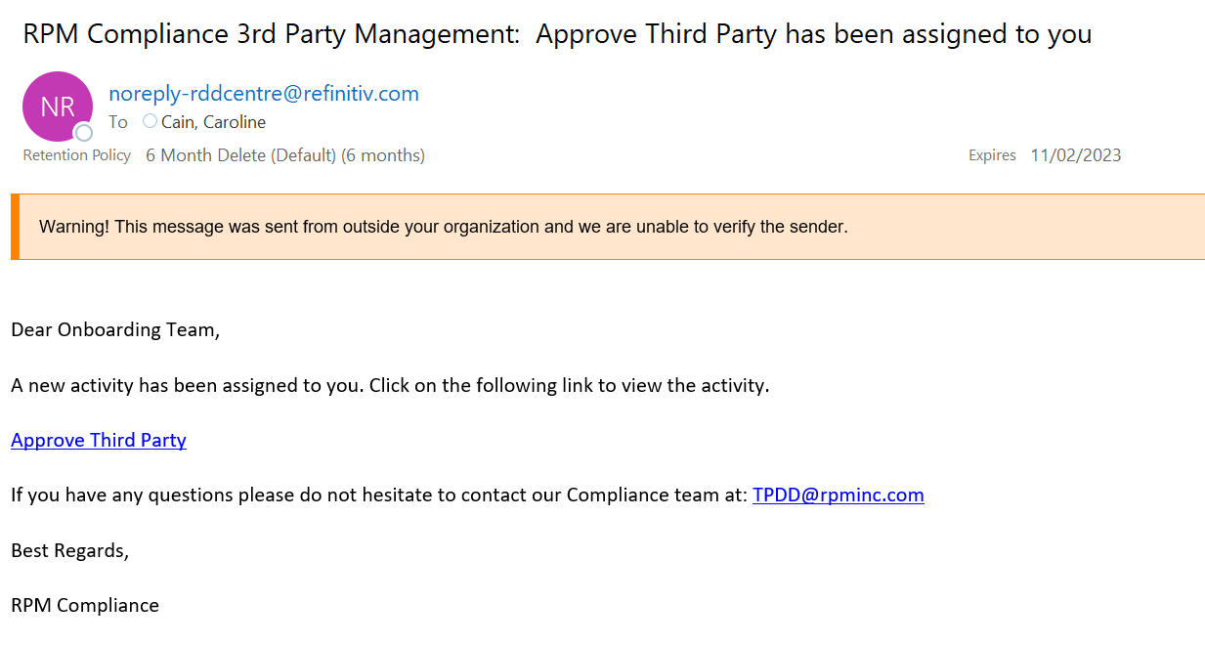
Onboarding a Third-Party
Low Risk w/o Hits:
If a Third-Party scored Low Risk in the Risk Analyser and there were no World-Check matches in the World-Check screening, this is the assessment that will be selected.
As soon as the first activity is completed, an email is sent to the ONBOARDING TEAM, an example is included below and the next activity in the workflow will become editable:

Slide 38
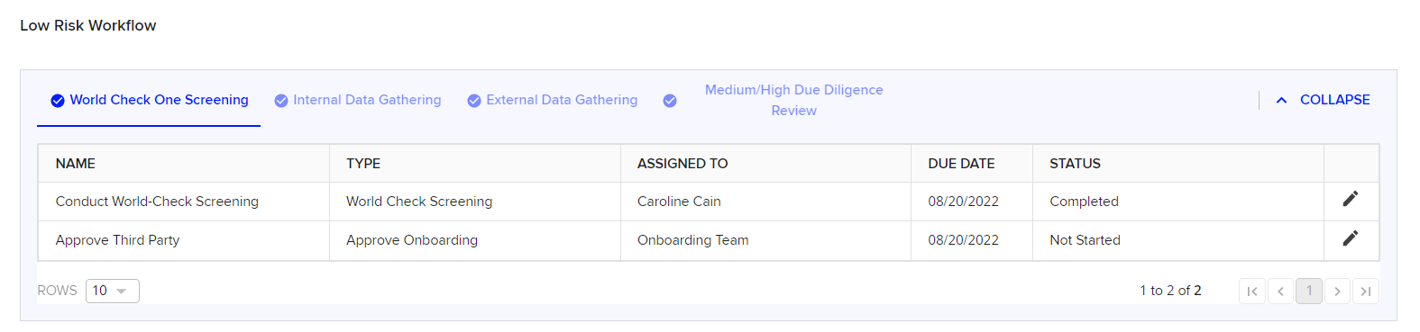
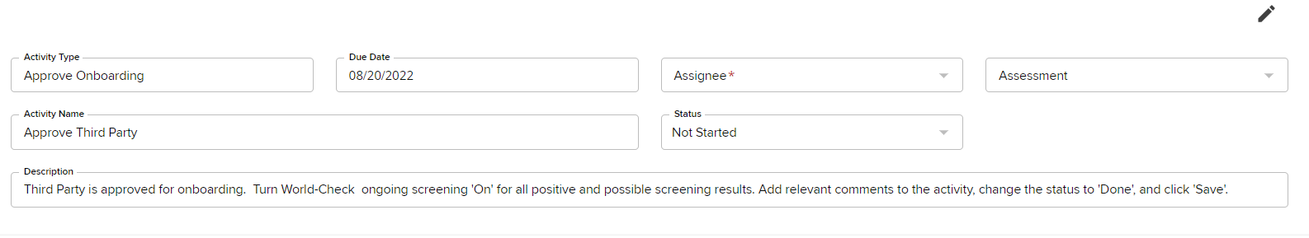
Onboarding a Third-Party
Low Risk w/o Hits (cont’d):
Because there were no issues with the Third-Party, the ONBOARDING TEAM is able to approve the Third-Party, which is the next and final activity to be completed in the workflow:
Use the pencil icon to be taken to the activity detail and again select User name in the Assignee list, change status to Done and click Save (at bottom of page). There is no Assessment to be made, as the Third-Party is automatically approved. By completing this activity, the Status of the Third-Party is changed from Onboarding to Onboarded. An email will be sent to confirm the Third-Party has been approved.

Slide 39
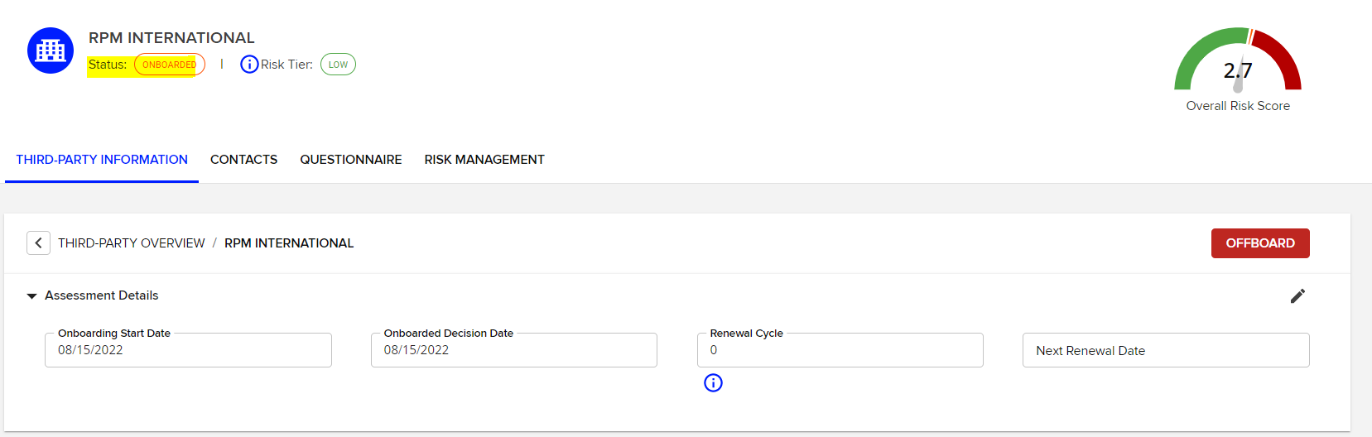
Onboarding a Third-Party
Low Risk w/o Hits (cont’d):
The Final step is to assign a Renewal cycle for when the Third-Party should be re-evaluated. For Low Risk Third-Parties, this is recommended to be every 3 years, Medium Risk Third-Parties every 2 years and High Risk Third-Parties every 1 year.
Note: This is entered in DAYS, not years (1 year = 365 days, 2 years = 730 days, 3 years = 1095 days)

Slide 40
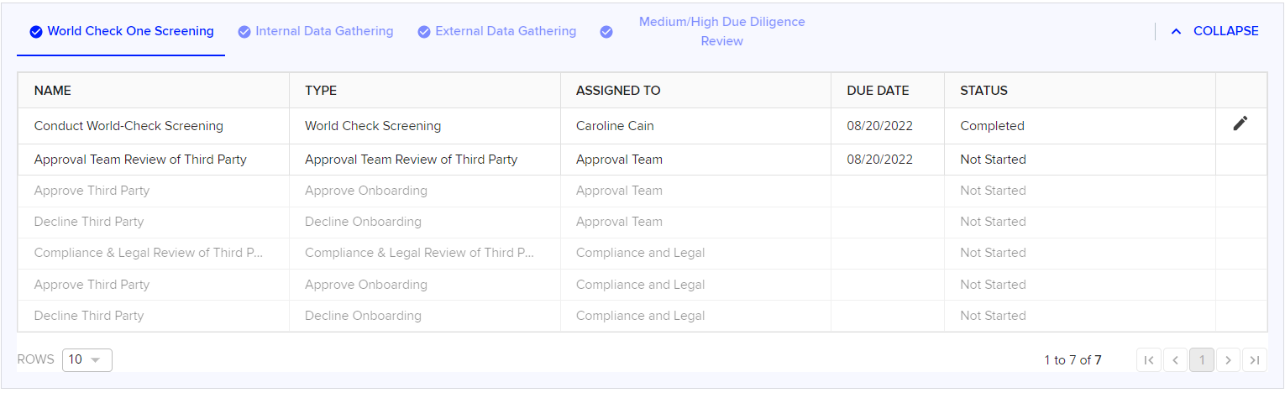
Onboarding a Third-Party
Medium / High Risk w/o Hits & Possible Hits Found:
If a Third-Party scores Medium or High Risk on the risk analyser and has no confirmed world-check matches in the screening results, OR, if a Third-Party has possible or positive world-check matches (regardless of risk level), then approval is required by the local Finance Approval Team.
The Steps are the same for the Onboarding Team as per the previous pages, the assessment selected will be different, which will then drive different activities in the workflow, as can be seen in the screenshot below:

Slide 41
Onboarding a Third-Party
Medium / High Risk w/o Hits & Possible Hits Found (cont’d):
Once the Onboarding Team have assessed the World-Check screening and assigned the result, then it is the responsibility of the local approval team to determine the next steps of the Workflow.
The Finance Approval Team have a host of assessment options when reviewing Third-Parties. These include:
Approve Third Party: If the local approval team are comfortable with the results of the world-check screening, or the risk score of the third party, they can approve the third party.
Decline Third Party: If there is a something in the world-check screening results, or additional information gathered about the third-party that the approval team are not comfortable with, they can decline the third party.
Request additional review from RPM Compliance Team: If the local team do not feel comfortable approving the third party, they can request the RPM compliance team to perform an additional review.
Proceed with Onboarding (which would then trigger the next stage of the Workflow through Internal Data Gathering): If the approval team feel additional information needs to be gathered about the third-party, then they can move onto the next stage of the workflow and move onto the internal data gathering stage.

Slide 42
Onboarding a Third-Party
Medium / High Risk w/o Hits & Possible Hits Found (cont’d):
Why would the Approval Team choose to Decline a Third-Party, send to Compliance for additional review or proceed to an Internal Questionnaire?
Here are a few examples as guidance as to how you would select the assessment for Medium / High Risk Third-Parties and those that have positive world check matches:
Red Flags in WC results:
Convictions for corruption or bribery, fraud, money laundering etc Convictions for Price fixing / bid-rigging, contravention of competition law etc.
Breaches of Labour Law / Human Rights abuses
Imposed fines for unethical or illegal conduct
Any association with a Government / State owned entity
Fines issued for breach of Safety or Environmental Laws
Declining a Third-Party:
The Third-Party is owned by a company that is in an embargoed country or has strong associations with a sanctioned country
The Directors / major shareholders are restricted parties / denied party lists
There is a Red-Flag that is in direct contravention of RPM’s V&E 168.
Results such as this may make the approval team choose to proceed with onboarding to the next stage of the workflow (i.e. Internal Questionnaire or send to Compliance Team for a second opinion who can approve, decline or request an Internal Questionnaire also.
Contact the RPM Compliance Team if you are ever unsure of a World-Check Result

Slide 43
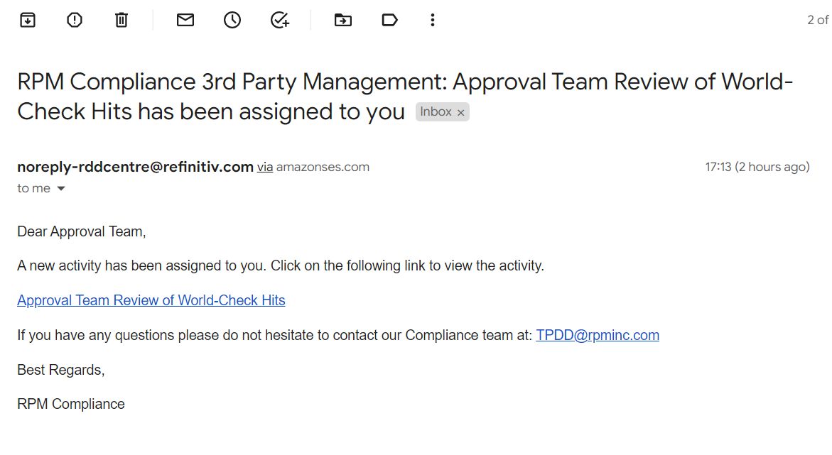
Onboarding a Third-Party
Medium / High Risk w/o Hits & Possible Hits Found (cont’d):
The Approval Team will receive an email notification once the Onboarding Team has selected the relevant assessment. An example of that is included below:
Clicking on the link will take the Approval Team directly to the activity. From there they can review the possible world check matches and select the relevant assessment.

Slide 44
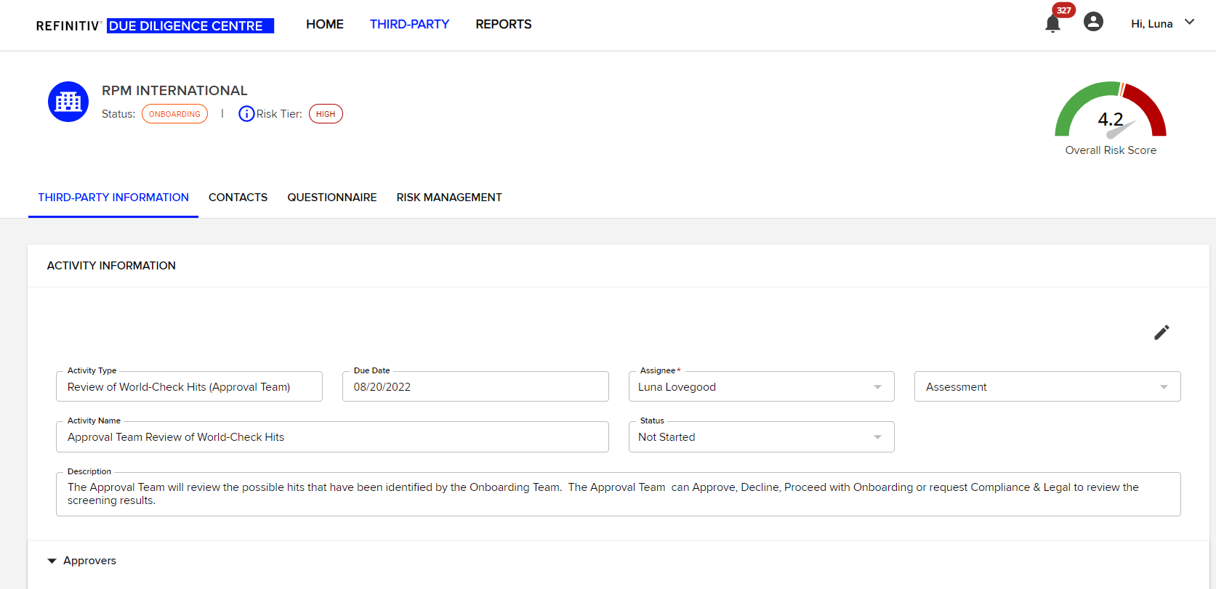
Onboarding a Third-Party
Below is the screen you are taken to once you have clicked on the email link. To get back to the World-Check Screening result, click on Third-party information and scroll down to the World-Check results. You should be able to see the resolved results and review the Third-Party selected as POSITIVE or POSSIBLE by the Onboarding Team.
Once the approval team have completed their review, they return to the activity and select the relevant assessment (see page 36 for assessment options).

Slide 45
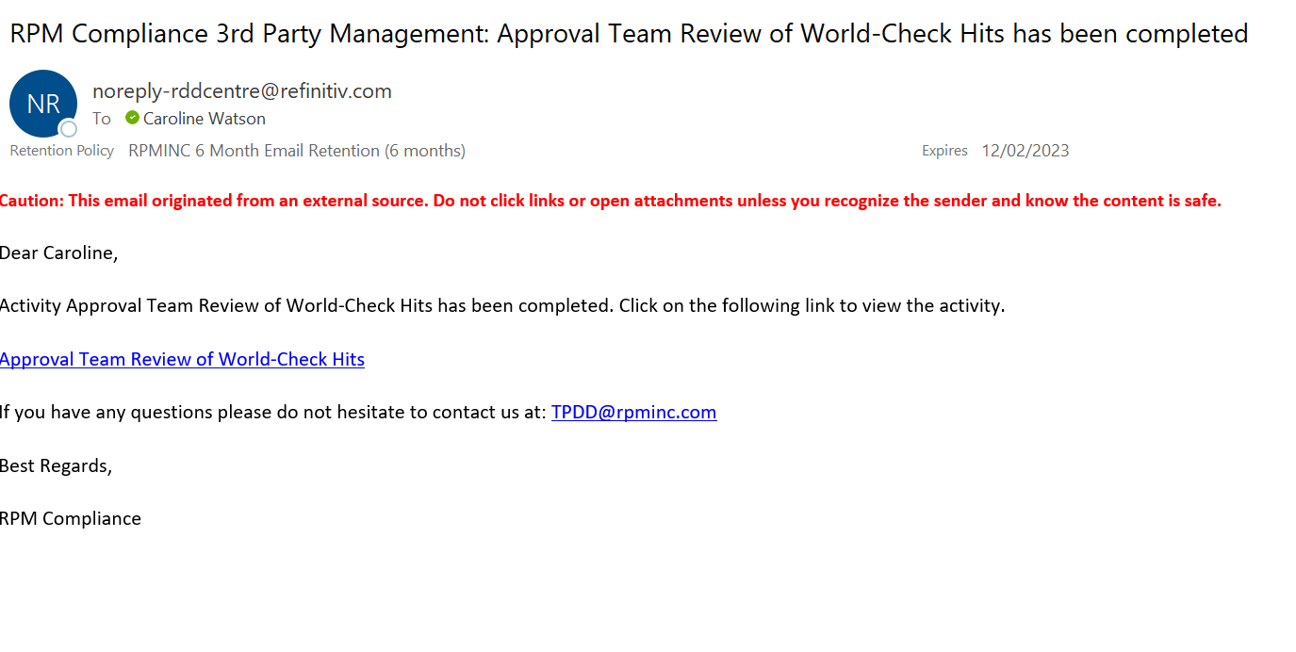
Onboarding a Third-Party
When the Approval Team have made their assessment, an email is sent to the Onboarding Team to let them know that the activity has been completed. By clicking on the link, they can review the status of the Third-Party Approval.

Slide 46
Onboarding a Third-Party
Other things to note within an activity:
Within an activity, there is the possibility to upload any additional documents (credit check searches etc), anything that you think relevant as part of your local due diligence procedures. Documents are uploaded the same as any other type of upload function. Uploads can be completed by any type of user.
Comments can be made in the comments section of the activity at any point in time, again by any type of User
The Approval Team can ask for an additional review of a World-Check screening result, the same way as highlighted in section 3 of this manual.
The Approval Team need to set the Renewal Cycle of the Third Party once approved as per the instructions for the Onboarding Team in Low Risk scenarios.

Slide 47
Assigning Questionnaires
Stages 2 and 3 of the Workflow are the Internal and External Data Gathering stages. These would be used when we have concerns about the integrity or the eligibility of the Third-Party and as such we want to gather additional information about them prior to conducting business with them.
It is not mandatory that all Third-Parties have to complete stages 2 and 3 of the workflow, these are only completed with Higher Risk Third-Parties and where we have concerns over their World-Check Screening results. This is detailed in Section 4 of this Training Guide.
Stage 2: Internal Data Gathering
Stage 2 of the Workflow only becomes activated when the Approval Team select “Proceed with Onboarding” as their assessment in the review of a Third-Party in the World-Check Screening (Stage 1) of the Workflow.
Usually Internal Questionnaires are assigned by the APPROVAL team and completed by the ONBOARDING team, however, the approval team user has the ability to assign to anyone in their organisation that is set up as a User within the system.
It is possible to assign Internal Questionnaires at any time of the onboarding process, however it is most likely they will only be issued as part of the workflow process.
Both will be covered on the next few pages…

Slide 48
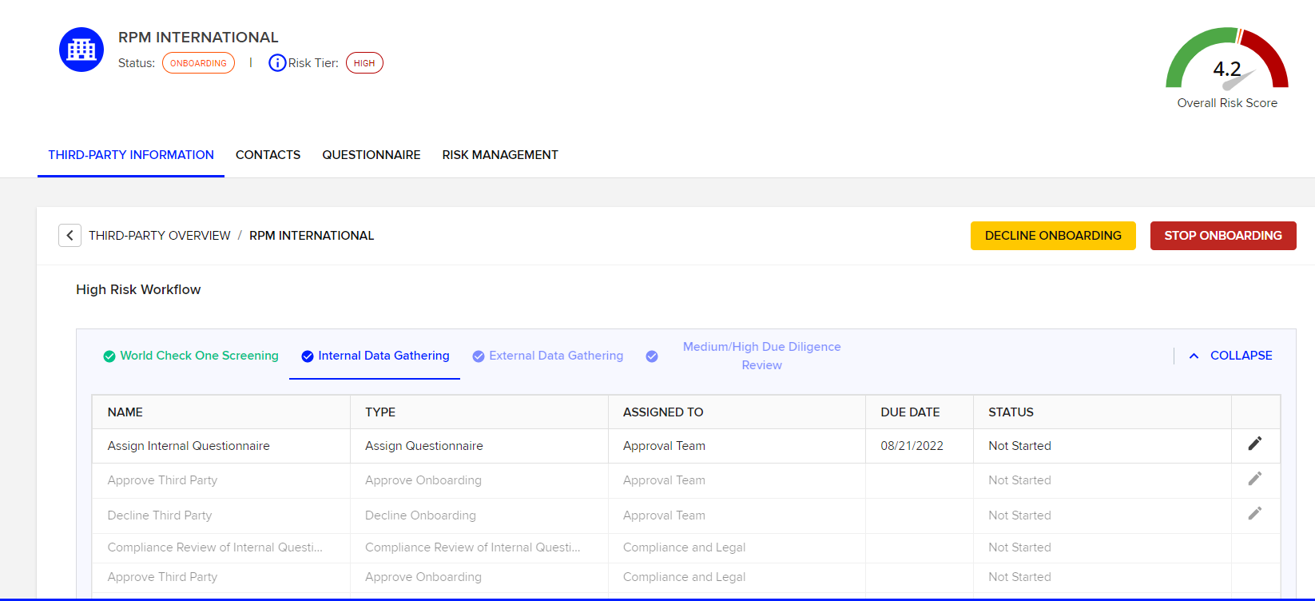
Assigning Questionnaires
As can be seen in the Screenshot below, when all the activities in Stage 1 have been completed, the tab turns green and the next tab becomes accessible. The First activity to be completed in Stage 2 of the Workflow is for the Approval Team to assign a questionnaire to another User within the organisation, usually a member of the Onboarding Team.

Slide 49
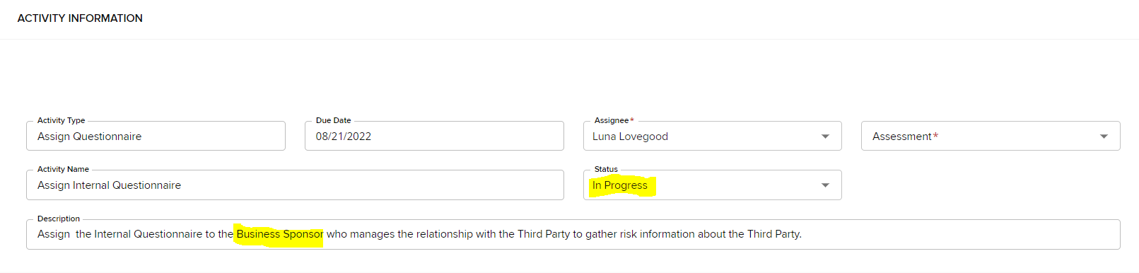
Assigning Questionnaires
First, click within the activity “Assign Questionnaire” and select in the Assignee box, the name of the Approval Team member who is completing the activity (i.e. who is assigning the questionnaire), and change the Status to “In Progress”, then scroll to the bottom of the page and click SAVE.
This just means you can assign to anyone who is a User in the system and has the capacity to complete the information in the Internal Questionnaire

Slide 50
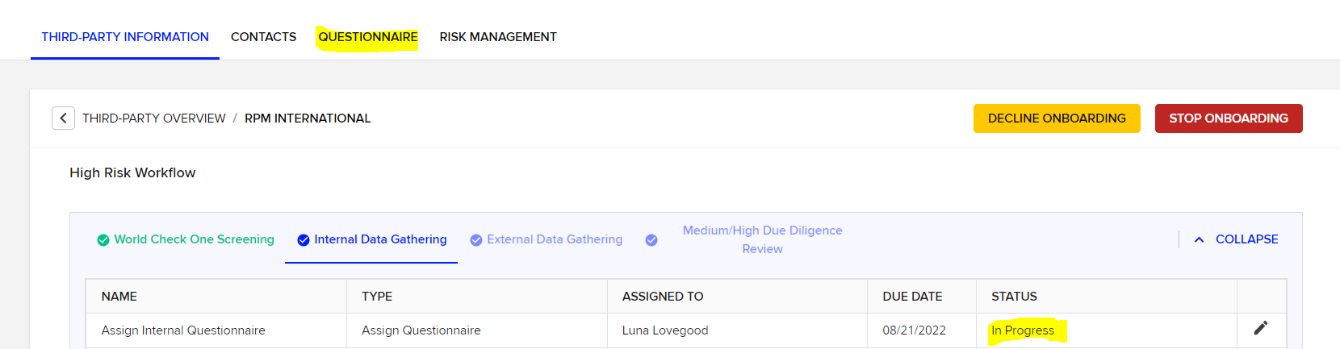
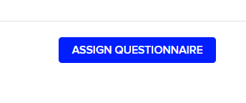
Assigning Questionnaires
Now you can see that the Activity status has changed to In Progress.
Next, you need to go to the Tab entitled QUESTIONNAIRE as highlighted in the Screenshot below…
Then click on the button that says

Slide 51
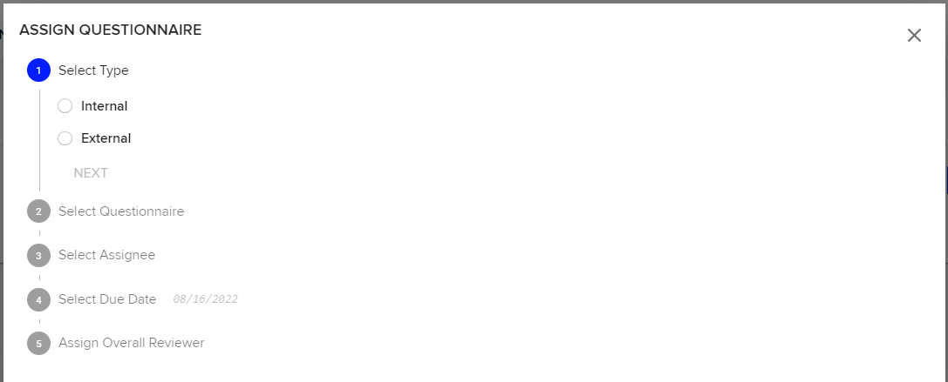
Assigning Questionnaires
A pop up Box will appear as per the screenshot below. Follow the steps to assign an Internal Questionnaire to a User.
The Assignee can be any User who is best to complete the Information requested in the Internal Questionnaire
Select yourself or leave blank if you want to be able to reviewed by anyone in the Approval Team

Slide 52
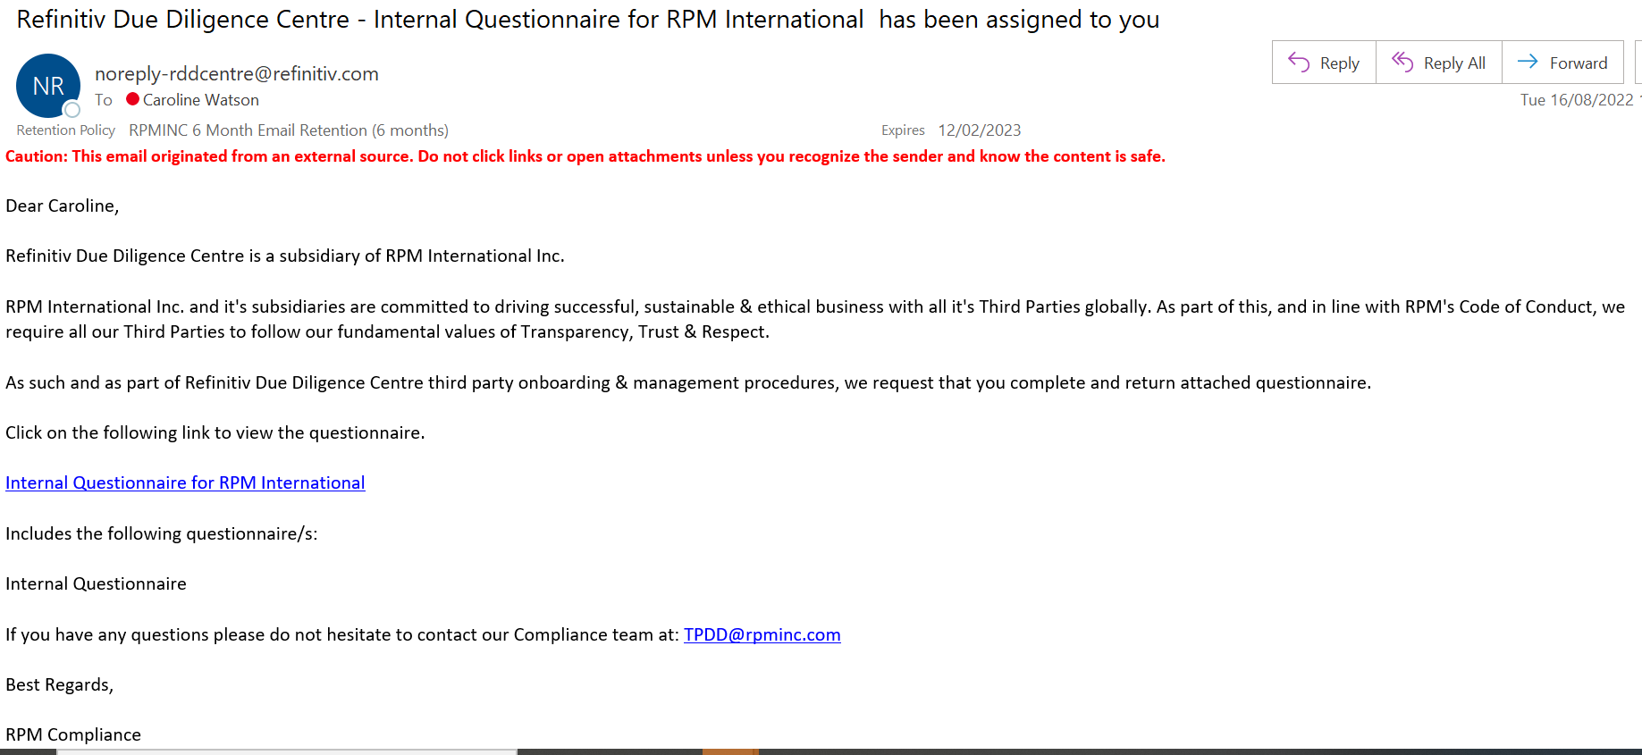
Assigning Questionnaires
When the Internal Questionnaire has been assigned, the assignee will receive an email to let them know a questionnaire has been assigned to them to complete.

Slide 53
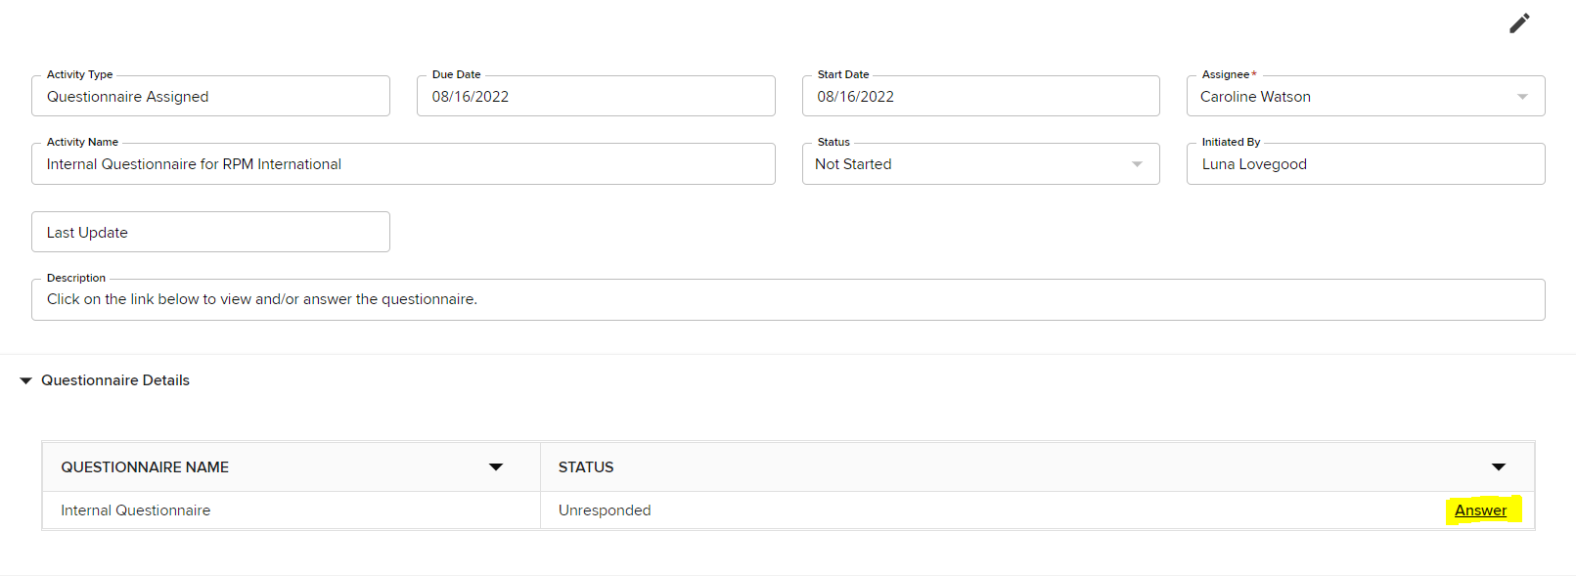
Assigning Questionnaires
Completing the Internal Questionnaire
The User assigned the questionnaire can click on the link in the email or log on and look at Assigned Activities on the Home Page to be taken to the Questionnaire Activity.
As highlighted on the screenshot above, click on “Answer” to begin answering the Internal Questionnaire questions.

Slide 54

Assigning Questionnaires
The Internal Questionnaire can be completed on the screen, but can also be exported to a PDF if a paper copy is required (however note that the questionnaire has to be completed within the system).
Certain questions within the Internal Questionnaire are scored to provide a Total Risk score for the Third-Party.
Not all questions are mandatory, the questionnaire will notify you which questions are required to be answered.
The majority of questions can be answered through a Drop Down menu and there is skip logic within the questionnaire based on the responses provided.
Tips and guidance for completing the Internal Questionnaire are included on the following pages:

Slide 55
Assigning the Questionnaires
Completing the Internal Questionnaire (IQ):
The first couple of questions is General Information about the Third Party, including name and location of Third-Party
The next question asks about the countries in which we are anticipating transacting with the Third-Party. This is a multi-answer questions, so if we expect to receive, send or transit goods through more than one country, we can list this here.
The IQ then asks a question about the size of your entity third-party revenue (RPM subsidiary), with a drop down menu to select your response. The reason this question is asked is because the risk profile of a large organisation will be different to the risk profile of a smaller organisation. The answer provided will therefore enable the scoring of certain questions to be automatically adjusted in accordance with your entity size.
The IQ asks about the total expected annual transactional value with the Third-Party in order to gauge the “size” / materiality of the relationship
The next set of questions request information about the person completing the IQ

Slide 56
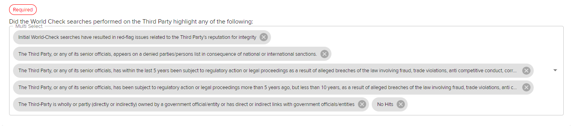
Assigning the Questionnaires
Completing the Internal Questionnaire (IQ):
The IQ asks for the Commodity Type or Third Party Type. The same way that the Risk Analyser uses the Third-Party type to determine the initial risk score, the third party type will also be factored into the overall risk score in the IQ.
For definitions of Third-Party Types, see page 11 of this training manual.
The IQ also asks about any information that may have been present in the World-Check search results (if any). More than one answer can be selected, the below screen shot shows all possible answers to the question:

Slide 57
Assigning Questionnaires
The IQ then asks a series of questions covering key topics such as:
  Conflicts of Interest
  Government association
  Commercial Considerations, including payment methods
  Specific questions relating to any possible Red-Flags, including trade, corruption and commercial red-flags.
It is not expected for the person completing the questionnaire to be able to answer all questions at once. This is why it may be easier to export as PDF so that a copy of all questions is to hand whilst the information is gathered. It is also possible to Save the questionnaire as a draft by scrolling to the bottom of the screen within the IQ.
Once the IQ has been completed, click SUBMIT at the bottom of the page.
The Approval Team will receive notification via email to let them know a IQ is ready for review. An example of the email is included on the next page…

Slide 58
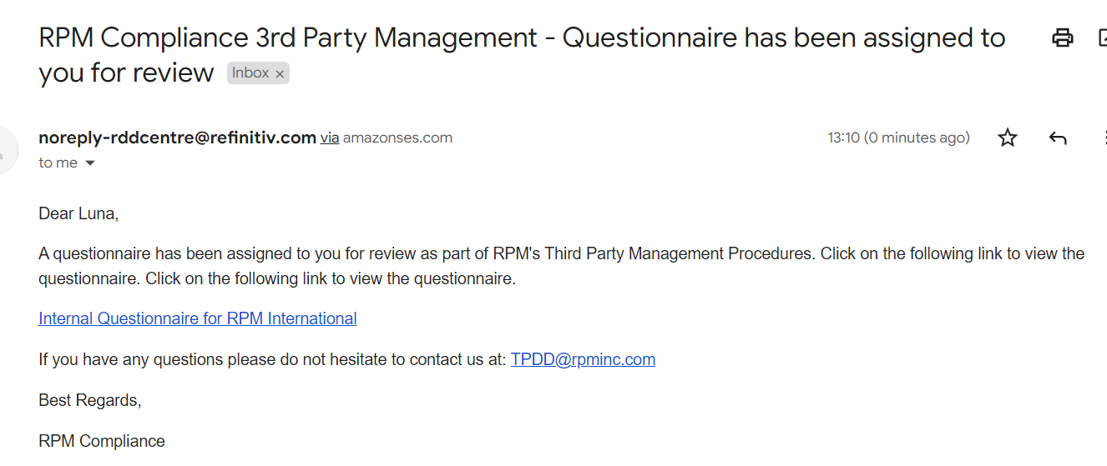
Assigning Questionnaires
The Approval Team User can click on the link in the email or log on to the system and from the Home Page click on Items to Review (make sure in Drop Down menu on screen you change from Activity to Questionnaire or else you won’t be able to see what is required to review) to access the Internal Questionnaire.

Slide 59
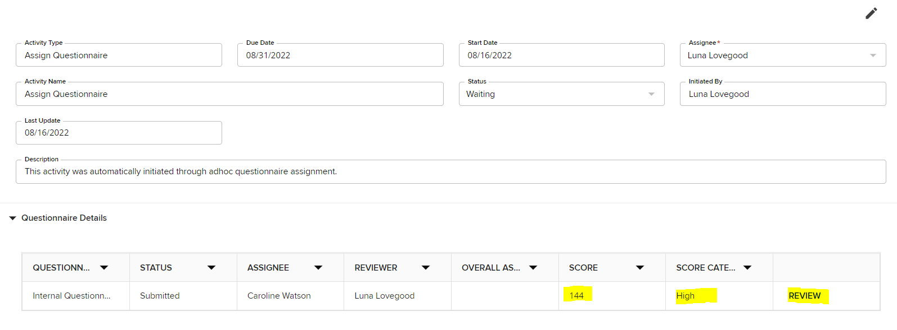
Assigning Questionnaires
Reviewing the Internal Questionnaire
Completed by the APPROVAL team
When the Approval team user accesses the item for review, they will be able to see the total score of the IQ and the Risk Category. From here they will also be able to click on the Review button to be taken to the questionnaire to review in detail.

Slide 60
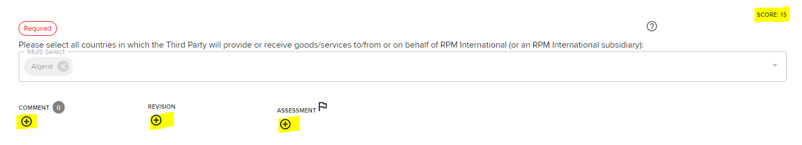
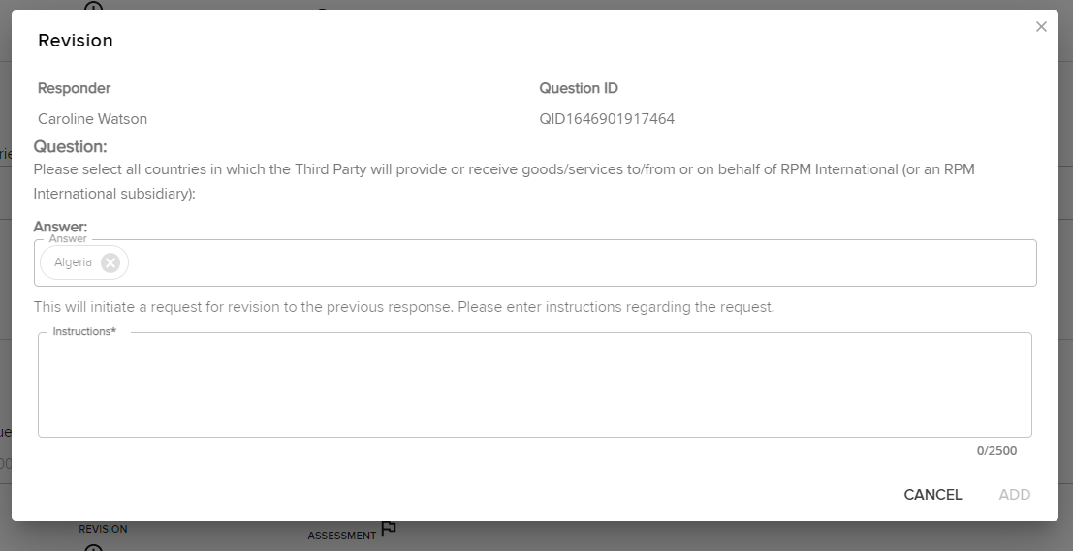
Assigning Questionnaires
For every question answered in the IQ, the reviewer can see the scoring awarded to each answer and has the option to add comments, request revisions to responses, or make assessments. If you click on Revision, the below pop up box appears where you can enter the revision you require the assignee to make.

Slide 61
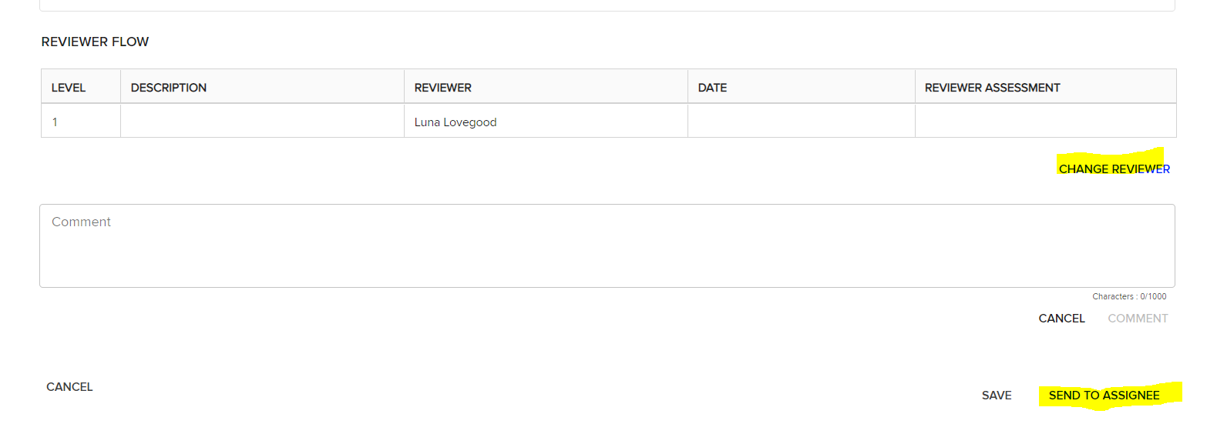
Assigning Questionnaires
At the base of the IQ, the reviewer can look to change the reviewer if they want the information double checked and they can also send back to the Assignee once all the revision requests, comments etc have been made by the reviewer.

Slide 62
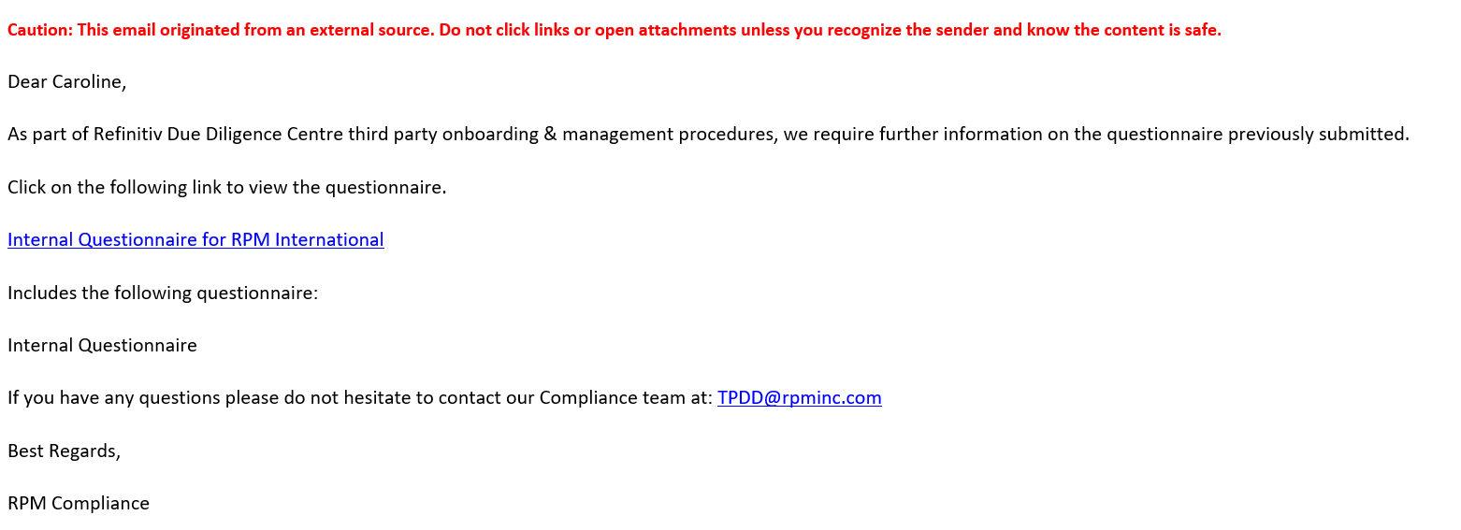
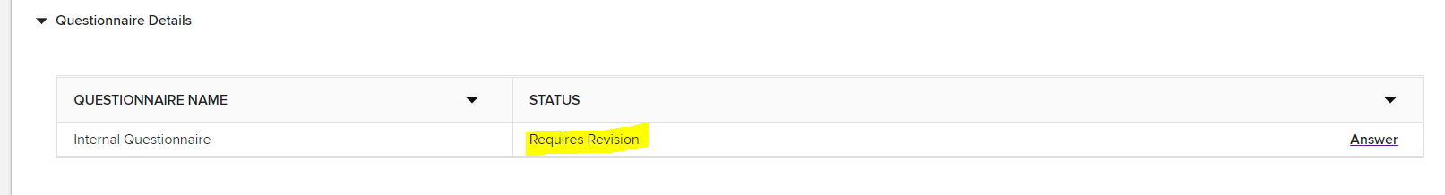
Assigning Questionnaires
The Assignee that completed the Questionnaire to let them know additional information / revision are required. An example is included below:
Clicking on the link will take the user to the questionnaire where they can revisit answers:

Slide 63
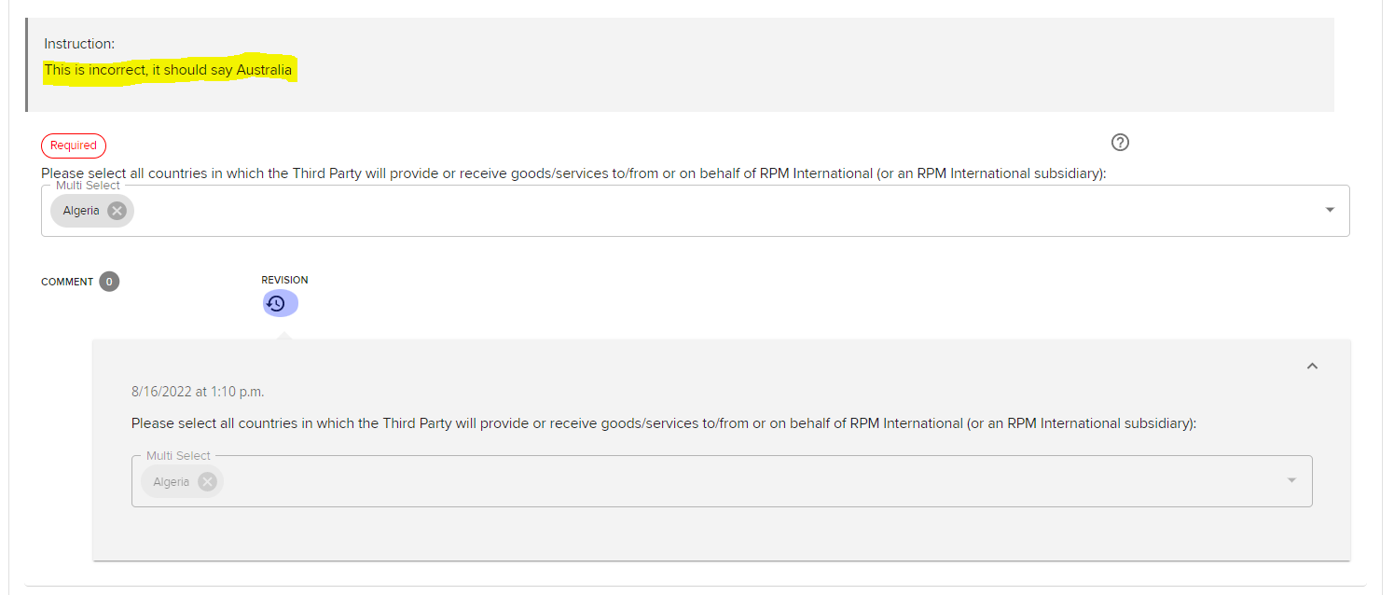
Assigning Questionnaires
The User completing the questionnaire can then scroll through the IQ and then can see where the reviewer has left them an instruction as to how the questionnaire requires amendment. They can make the changes and resubmit for review.

Slide 64
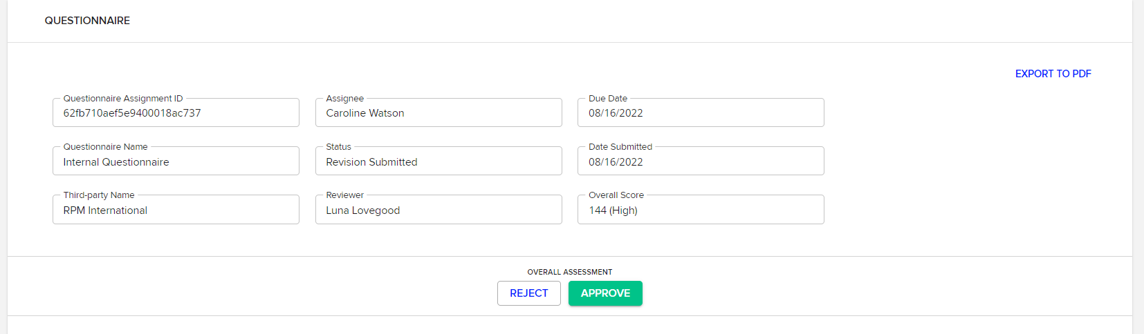
Assigning Questionnaires
Once all revisions (if any) have been made to the Internal Questionnaire, it can be approved by the reviewer. The Reviewer will access the submitted questionnaire in the same way as when initially submitted, either through the link on the email or via the Items to Review section on the Homepage. At the Top pf the questionnaire, the reviewer is then able to REJECT (meaning it will have to be completed again) or APPROVE the questionnaire. (Note: approval is just to approve the questionnaire as complete – it is not approving the third party to be onboarded).
Once this has been completed, the Reviewer can return to the activity in the Internal Data Gathering Section of the workflow and update the Assessment in the Activity for the Results of the Internal Questionnaire.

Slide 65
Assigning Questionnaires
The Assessment Options for the Internal Questionnaires depend on the total score of the Internal Questionnaire, as follows:
The IQ scored Low Risk – Approve Third Party
The IQ scored Medium Risk – Approve Third Party
The IQ scored Medium Risk – Request Compliance Review
The IQ scored High Risk – Requires Compliance Review
Decline Third Party
Assign External Questionnaire
For Medium Risk scores, the local team can choose whether to approve or send to Compliance Team. For High Risk scores, a Compliance Review is mandatory or they can issue an external questionnaire
The Compliance Team upon review have the option to approve or decline the third-party, or request the completion of an external questionnaire.
The local approval team may decide to decline the third-party if it scored a high risk score in the IQ and decide not to transact with them, or they may decide that they want to gather even further information about the third party, in which case, they would select the Assign External Questionnaire Assessment.
This will be covered in the next few pages…

Slide 66
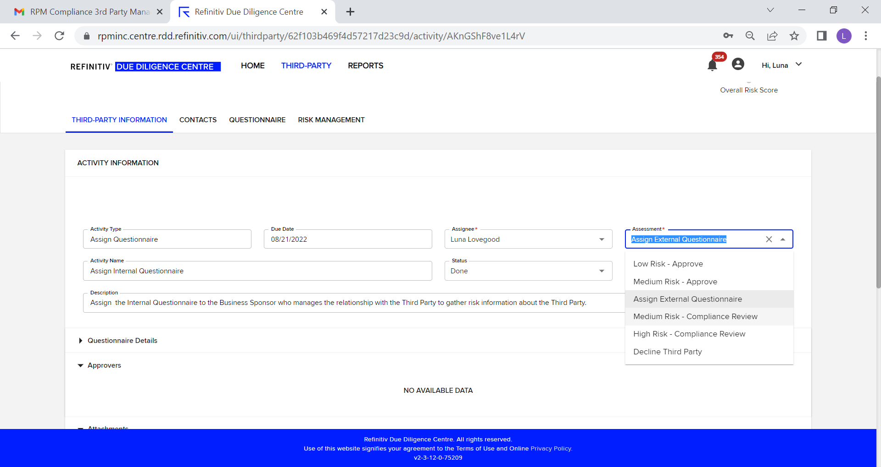
Assigning Questionnaires
Below is a screenshot, showing the assessments available for the results of the Internal Questionnaire…

Slide 67
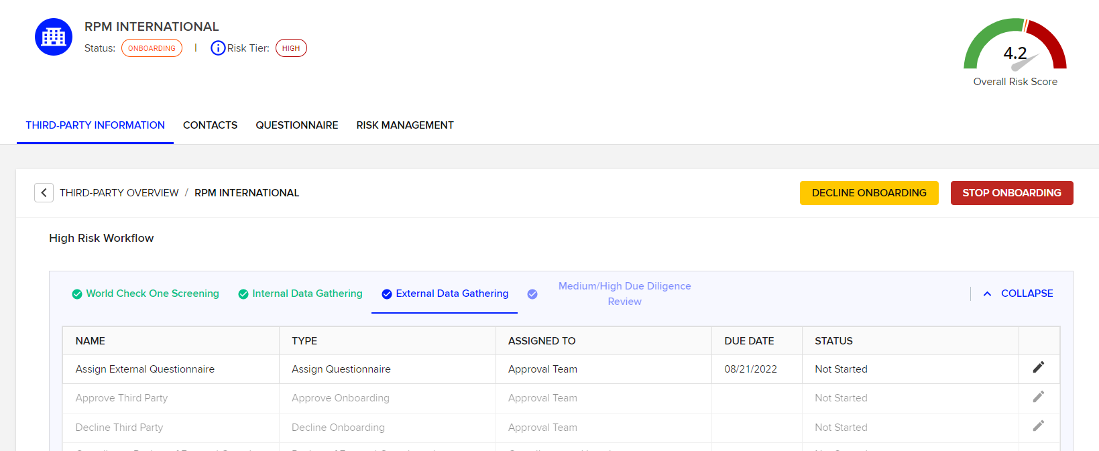
Assigning Questionnaires
Stage 5: External Data Gathering
When the approval team select, Assign External Questionnaire in the Assessment (see prior page), the External Data Gathering Tab (Stage 3) of the workflow becomes activated.
As you can see, both the World Check Screening and the Internal Data Gathering Tabs are coloured Green to show that all activities have been completed.
Similar to the Internal Questionnaire, the first activity to be completed is to Assign the External Questionnaire.

Slide 68


Assigning Questionnaires
As with the Internal Questionnaire, click into the Assign External Questionnaire activity and change the status to In Progress and click SAVE, remembering to assign yourself as the owner of the Activity.
Before you can assign / send an external questionnaire to a Third-Party contact, you need to ensure the correct contact / Associated party is saved in the system and that they are “Enabled as User” (see next page)
From within the contact tab, select ADD ASSOCIATED PARTY

Slide 69


Assigning Questionnaires
Complete the contact info, ensuring a correct email address is included and that the Box for “Enabled as User” is checked
From within the Assign External Questionnaire, scroll to the bottom and select Assign Questionnaire.

Slide 70

Assigning Questionnaires
Complete the steps in the pop-up box, and for step 3 as highlighted below, your added contact should be searchable.
Once you have completed the steps, the recipient will receive an email asking them to complete the External Questionnaire

Slide 71

Assigning Questionnaires
The External Third-Party will receive a request from RDDC to set up a password and an email inviting them to complete the external questionnaire, a copy of this email is included below:
As this email is a set template for RPM, we would recommend that you communicate with your third parties to let them know they will be receiving the invite.

Slide 72

Assigning Questionnaires
When the Third Party logs on, they will have a Home Screen similar to the Internal User’s set up:
Once the Third Party has completed the External Questionnaire, the Approval Team user who assigned the questionnaire will receive an email notification to let them know it has been completed, a copy is included on the next page…

Slide 73

Assigning Questionnaires
The Review process for External Questionnaires is exactly the same as for Internal Questionnaires. Refer to prior pages for information as how to complete the review of External Questionnaires.

Slide 74


Assign Questionnaires
By clicking on the link in the email or logging onto the system and going to the activity, the reviewer can review the results of the External Questionnaire.
Once the Questionnaire is reviewed and any comments or revisions have been made (see Internal Questionnaire for instructions), the questionnaire can be approved or rejected.

Slide 75

Assigning Questionnaires
The Reviewer can then return to the Activity and change the status to Done and select the relevant assessment for the External Questionnaire.

Slide 76
Assigning Questionnaires
Reviewing External Questionnaires cont’d:
As with the Internal Questionnaires, the Assessments in the activity are driven by the Risk Score of the External Questionnaire. In the example screen shot on the previous page, the risk was high with a score of 80.
In very extreme cases where the third party is considered high risk, enhanced due diligence reports can be requested for an additional charge. This must be done through the RPM Compliance Team.

Slide 77



World Check Updates Review Process
When a third party has an update to an existing World Check match or there is a possible new match LSEG notifies the person labeled as the Responsible Party of those updates.
When those updates occur, you will be able to locate them in the Items to Review tab and then the drop down menu under Screening as shown below.

Slide 78


World Check Updates Review Process
By clicking on the Third Party it will take you directly to the World Check record to review.
If the update is a possible new match you will need to determine if it is the same company as your Third Party and mark the Resolution type according.
Once that is completed you will mark the blue Review button as shown below

Slide 79



World Check Updates Review Process
If the new World Check item is a positive match, it then must be routed to the Approval Team for review to determine if there are any red flag issues that would prevent us from conducting business with that Third Party.
To send this to the Approval Team for review you would click on the blue Add Reviewer button highlighted below.

Slide 80





World Check Updates Review Process
LSEG will then open the below box for routing. Select User Group, select Approval Team in the Reviewers box, select a due date and click Create Adhoc Activity.
The Third Party will then be forwarded to the Approval Team members for their review.

Slide 81

World Check Updates Review Process
The Approval Team will then have the Third Party in their Items to Review tab for them to review and ensure that they wish to continue to conduct business with the Third Party.
If approved they would just hit the review button while in the World Check screening and proceed as always.
If any red flag issues are spotted that leads us to cease business activities they should Offboard the Third Party and then Decline the Third Party.

Slide 82

World Check Updates Review Process
If the World Check hit was previously marked a Positive match and there is new data in the World Check Further Information Tab, this should also be routed to the Approval Team for their review as above.

Slide 83


World Check Updates Review Process
If the new World Check hits are not matches or there is no new relevant data in the Further Information tab the Responsible Party may just hit the Review button to complete the task with no further review necessary.
*Please note that at any time the Approval Team members may create another Adhoc Activity and add another level of review and send to Compliance and Legal at RPM for assistance.

Slide 84

Renewals
Reviewing Renewals:
Based on the risk level all third parties when onboarded receive a renewal date. When that renewal date hits all of the Onboarding Team members for that third party’s division will receive a task to complete on their Home screen in LSEG.

Slide 85


Renewals
Reviewing Renewals:
To complete the renewal process the Onboarding Team will click on the third party name provided which will open the third-party.
At this time they should review the content of the third party, including the address and revenue amount to confirm that those are still accurate along with a review of the World Check/Media Check data.
To review World Check/Media Check they should hit the screening tab at the top.
If
They are looking for either a completely new match or any new information in a previously marked match.

Slide 86


Renewals
Reviewing Renewals:
Once they have completed review of the Details section and World Check/Media Check they can then start the renewal workflow by clicking Renew.

Slide 87

Renewals
Reviewing Renewals:
Once the Renew button is clicked it will open up the Renewal Workflow as shown below. This is very similar to the onboarding workflow.

Slide 88


Renewals
Reviewing Renewals:
From here they will click on the Pencil icon to complete the first step of the workflow.

Slide 89
Renewals
Reviewing Renewals:
The first step is to complete the Assessment. For the renewal process the Assessment options are as follows:
Low Risk w/o Hits
Medium Risk w/o Hits
High Risk w/o Hits
Possible 3rd Party Status Change
Decline Third Party
This is slightly different from the onboarding process. If there is no NEW data in World Check/Media Check or a significant status change that would need to go to the approval team; the Onboarding Team will pick one of the first three options to match the risk level of the third party.
If there is a new World Check/Media Check or status change, they then would pick Possible 3rd Party Status Change – which would then escalate it to Approval Team member to review and complete the renewal process.
And if we are no longer conducting business with the third party we always have the option to Decline Third Party to make them Offboarded.

Slide 90








Renewals
Reviewing Renewals:
Once they pick their Assessment below:
They will mark the status Done and hit save at the bottom of the page

Slide 91




Renewals
Reviewing Renewals:
This will open up the second step of the workflow where they will need to hit the pencil icon to open.
They will mark the status as Done which will approve the third party for onboarding.

Slide 92



Renewals
Reviewing Renewals:
This completes the workflow. As you can see below the Status is back to Onboarded and the renewal date has reset to the next renewal time.

Slide 93



Renewals
Reviewing Renewals:
If there was a NEW World Check/Media Check or status change and they completed the Assessment with Possible 3rd Party Status Change it then has moved to the Approval Team to review:
This will then be in their Assigned Activites on the Approval Team’s home page.

Slide 94


Renewals
Reviewing Renewals:
The Approval Team member will review the Screening and Details section to make a determination so they can complete the Assessment. To complete the Assessment they will click on the pencil icon as highlighted below:

Slide 95

Renewals
Reviewing Renewals:
The Approval Team has 4 options:
Approve Third Party – which completes the onboarding renewal process.
Proceed with Onboarding – which opens up the Questionnaire workflows
Compliance Review of Third Party – sends to the Compliance Team
Decline Third Party
These steps are identical to the onboarding process as referred to on Page 40 of this manual.

Slide 96




Renewals
Reviewing Renewals:
In most cases the Approval Team will Approve Third Party which will open up the last step of the workflow:
They will mark the status as Done to approve the third party for onboarding and hit save at the bottom of the page:

Slide 97


Renewals
Reviewing Renewals:
At this point the third party has been successfully renewed and the status is back to Onboarded with the updated renewal date.

Slide 98
End of Training

